Slide 1
3b. Develop DE workflow
Notes:
As of 2/21/2020

Slide 2
Meeting Agenda
Topic | Time | Presenter
Delta Live Table | 60 mins | Nara
Streaming capability | 60 mins | Jake
Job logging details and DB workflow | 30 mins | Nara
Cost analysis and optimization | 30 mins | Jake
Cost analysis and optimization (Gilead-DnA's infra) | 10mins | Anthony

Slide 3


Meet the Team
To add or arrange timeline elements, manually move and edit text group.
NOTE
Name
Pronoun1/2/3
Job Title
Name
Pronoun1/2/3
Job Title
Name
Pronoun1/2/3
Job Title
Name
Pronoun1/2/3
Job Title
Name
Pronoun1/2/3
Job Title
Name
Pronoun1/2/3
Job Title
Name
Pronoun1/2/3
Job Title
Name
Pronoun1/2/3
Job Title

Slide 4
Delta Live Table

Slide 5
We know data is critical to business outcomes
Customer experience
Product /Service Innovation
Business objectives
Operational efficiency
HIPAA
BCBS29
Governance & compliance
Revenue growth
DATA
CCPA
Self-service analytics
Analytics
& AI
GDPR
Predictive analytics
Digital modernization
Data warehouse / lake convergence
Data-driven decisions
Data migrations
Notes:
Organizations realize data is a strategic asset for various business-related initiatives such as growing revenues, improving customer experience, operating efficiently or improving a product or service. To support these business objectives, organizations rely on analytics or data science to drive decisions or predict outcomes which is supported by data engineering teams.

Slide 6


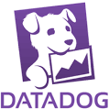






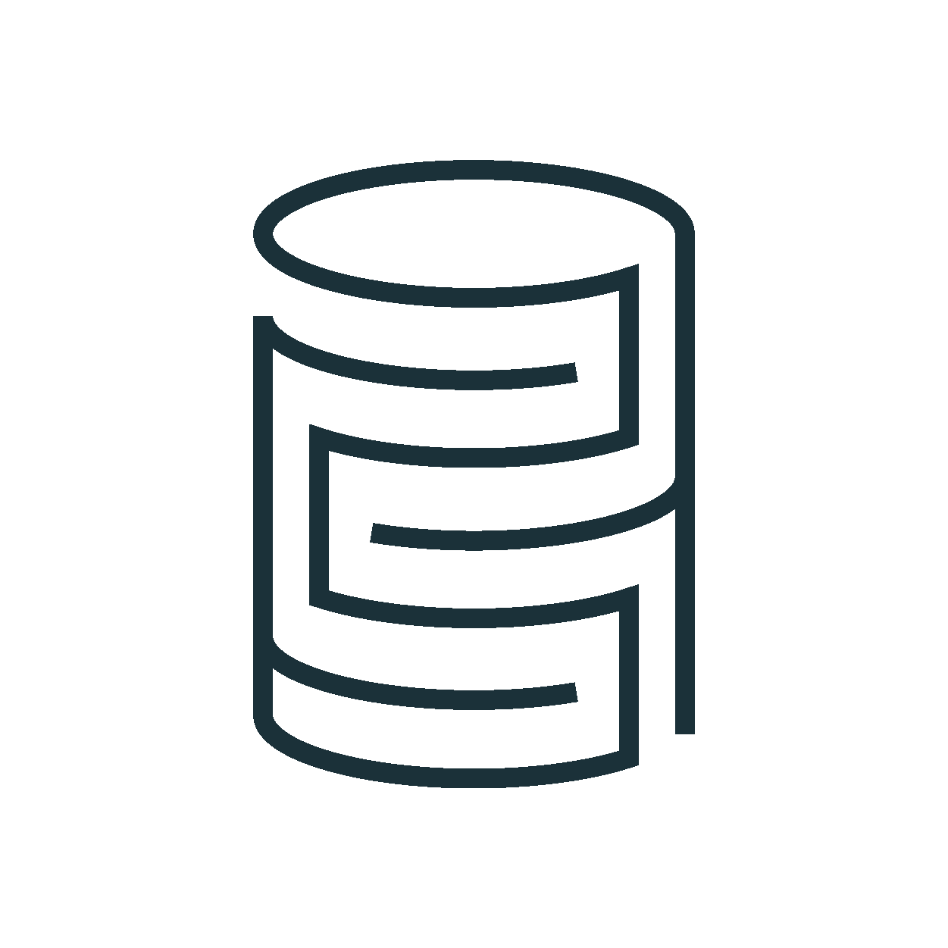


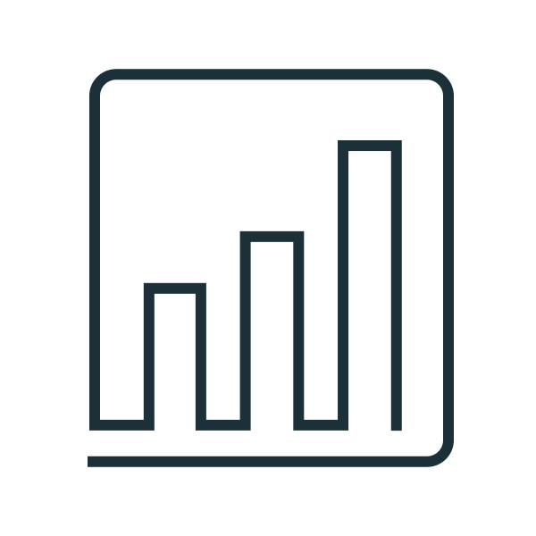



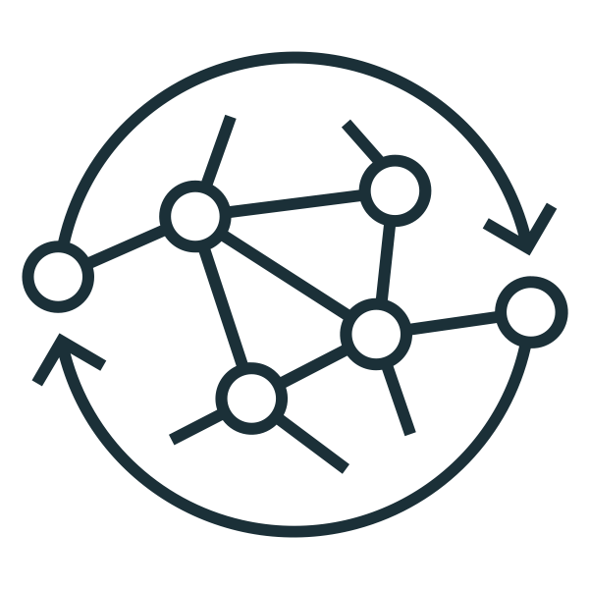
But there is complexity in the data delivery….
Home-
Grown ETL
Streaming Analytics
Data Sources
Streaming
Sources
Cloud Object Stores
SaaS Applications
NoSQL
Relational Databases
On-premises systems
TASK
FLOW
Azure Data Factory
TASK
FLOW
Unstructured
ETL
Home-
Grown ETL
ETL
Azure Synapse
Business Insights
Semi-structured
Code Generated
AWS EMR
ETL
Structured
Cloud Data Lake
ETL
Analytics
TASK
FLOW
ETL
AWS Glue
ETL
Machine
Learning
Data sharing
Notes:
But it isn’t an easy feat to achieve these outcomes when data engineering is complex.
Turning SQL queries into production ETL pipelines typically involves a lot of tedious, complicated operational work. Even at a small scale the majority of a data practitioner's time is spent on tooling and managing infrastructure.
This complexity lies in how data teams implement data engineering. We’ve seen organizations use a plethora of tools, EMR, Glue, ADF, Airflow, Oozie to support data engineering activities. Each of these tools are fragmented and require specialization which turns into a spaghetti for managing, building and maintaining data pipelines.
These data engineers need to know to know data management principles (etl, streaming, schema, table management, data security, data modelling), software engineering techniques on how to scale processing, build in error handling, or incorporate a retry strategy. Finally, these data engineers are responsible for the infrastructure. This complexity really slows down innovation and makes it difficult for any enterprise team to manage.
—------------------------
But getting data to support these initiatives is difficult. If you look at an organization's data landscape, this path isn’t straight forward. For example, just moving data to the lakehouse, they can use Fivetran, Rivery or Qlik but once they’ve moved the data, there is a lot of complexity. To standardize, transform data or even make sure the data is clean organizations implement many various tools, either cloud vendor specific, either a home-grown solution or various open-source technologies.
So how can Databricks help?

Slide 7
How does Databricks Help?

Slide 8




Delta Live Tables
The best way to do ETL on the lakehouse
Accelerate ETL development Declare SQL or Python and DLT automatically orchestrates the DAG, handles retries, changing data
Automatically manage your infrastructure Automates complex tedious activities like recovery, auto-scaling, and performance optimization
Ensure high data quality Deliver reliable data with built-in quality controls, testing, monitoring, and enforcement
Unify batch and streaming Get the simplicity of SQL with freshness of streaming with one unified API
CREATE STREAMING TABLE raw_data
AS SELECT *
FROM cloud_files ("/raw_data", "json")
CREATE MATERIALIZED VIEW clean_data
AS SELECT …
FROM LIVE.raw_data
Notes:
Delta Live Tables (DLT) is the first ETL framework that uses a simple declarative approach to building reliable data pipelines and automatically managing your infrastructure at scale so data analysts and engineers can spend less time on tooling and focus on getting value from data. With DLT, engineers are able to treat their data as code and apply modern software engineering best practices like testing, error handling, monitoring and documentation to deploy reliable pipelines at scale.
Accelerate ETL development:
Unlike solutions that require you to manually hand-stitch fragments of code to build end-to-end pipelines, DLT makes it possible to declaratively express entire data flows in SQL and Python.
In addition, DLT natively enables modern software engineering best practices like the ability to develop in environment(s) separate from production, the ability to easily test it before deploying, deploy and manage environments using parameterization, unit testing and documentation. As a result, you can simplify the development, testing, deployment, operations and monitoring of ETL pipelines with first-class constructs for expressing transformations, CI/CD, SLAs and quality expectations, and seamlessly handling batch and streaming in a single API.
Automatically manage infrastructure:
Sizing clusters for optimal performance given changing, unpredictable data volumes can be challenging and lead to overprovisioning. DLT automatically scales compute to meet performance SLAs by providing the user with the option to set the minimum and maximum number of instances and let DLT size up the cluster according to cluster utilization.
Error handling and recovery, and performance optimization are all handled automatically. With DLT, you can focus on data transformation instead of operations.
Data confidence:
DLT makes it easy to create trusted data sources by including first-class support for data quality management and monitoring tools using a feature called Expectations.
Expectations help prevent bad data from flowing into tables, track data quality over time, and provide tools to troubleshoot bad data with granular pipeline observability so you get a high-fidelity lineage diagram of your pipeline, track dependencies, and aggregate data quality metrics across all of your pipelines.
Simplified batch and streaming:
Unlike other products that force you to deal with streaming and batch workloads separately, DLT supports any type of data workload with a single API so data engineers and analysts alike can build cloud-scale data pipelines faster and without needing to have advanced data engineering skills.

Slide 9






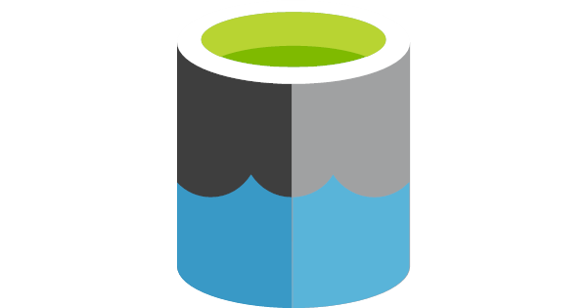
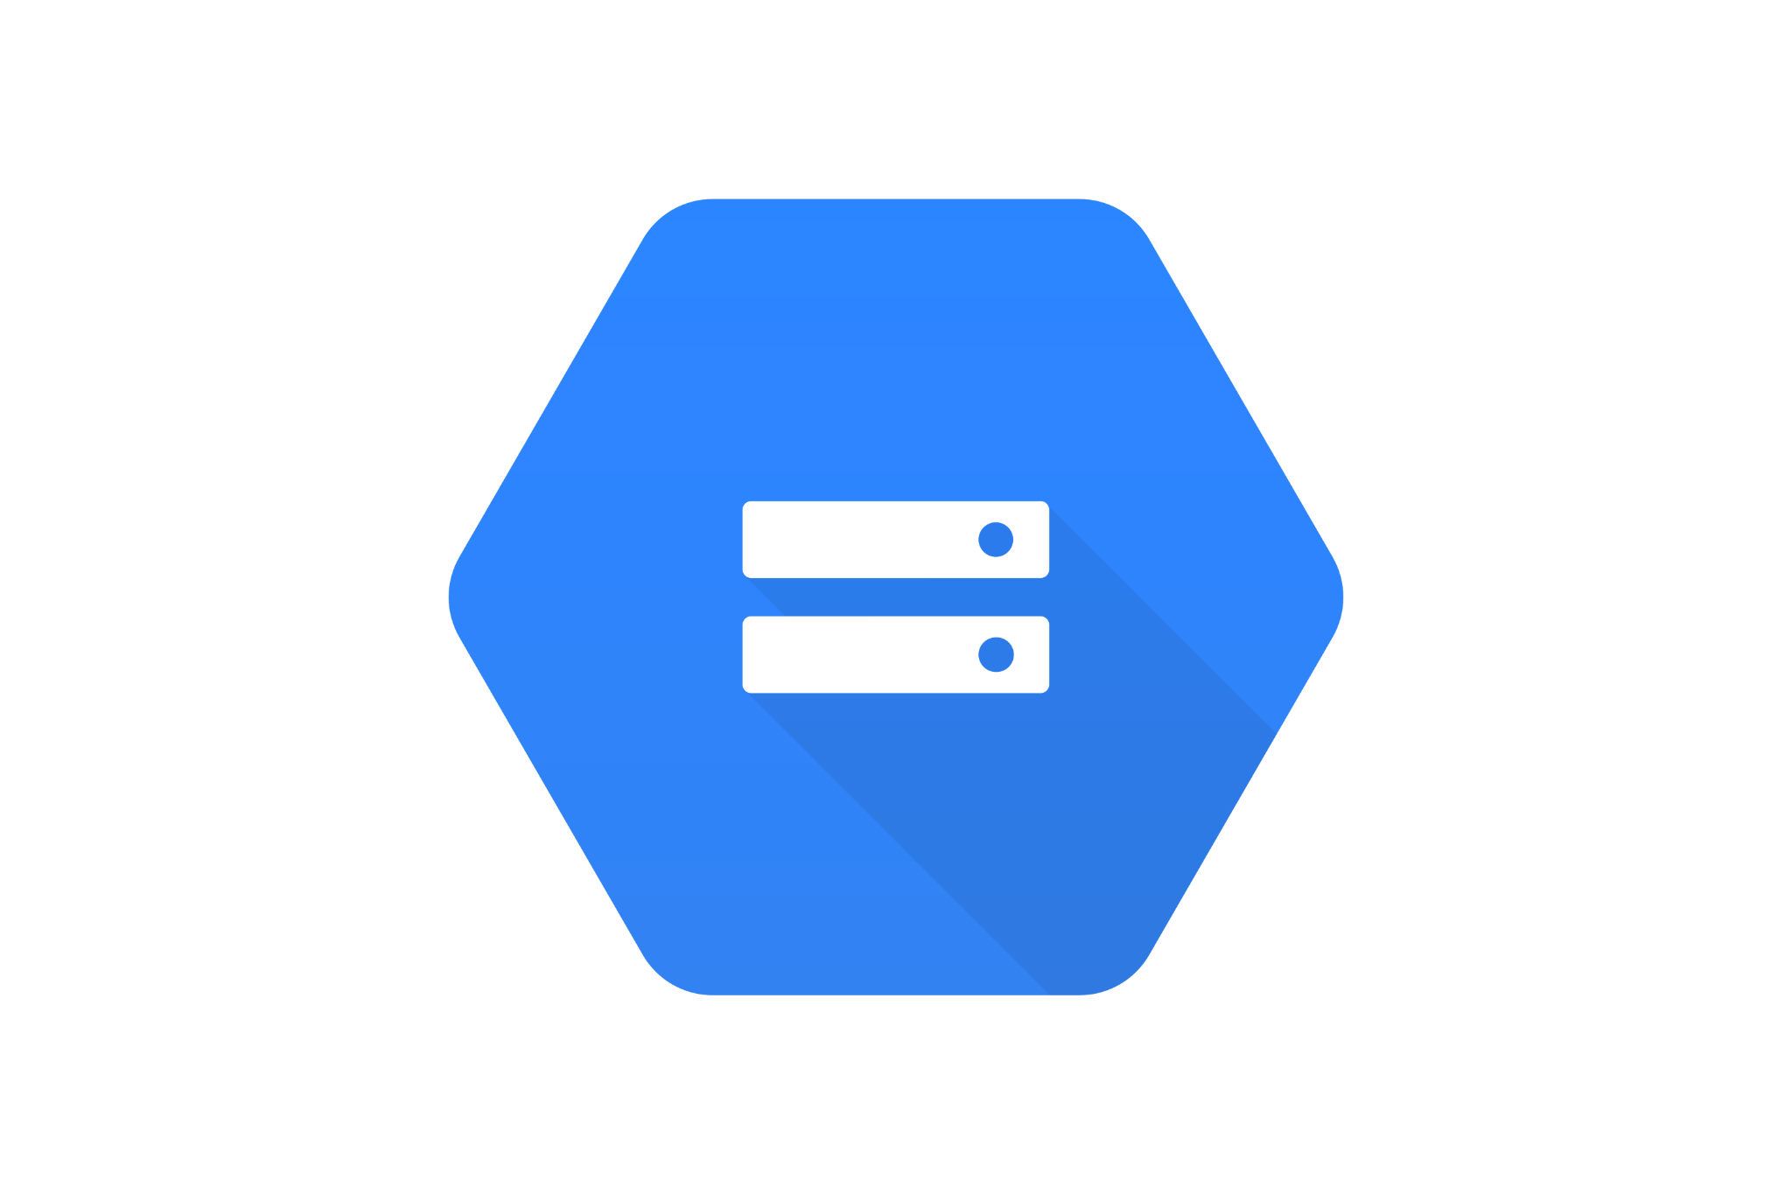

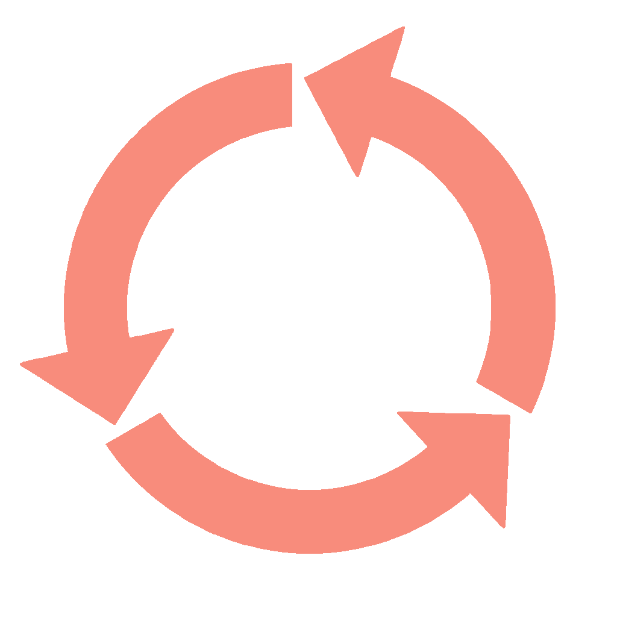









Build Production ETL Pipelines with DLT
Databricks Lakehouse Platform
Business Insights
Automatic Operations
Orchestration
Observability
Data Quality
CI / CD
Bronze Layer
Silver Layer
Gold Layer
customers
(Streaming Table)
Cloud Storage
customer_orders
(Materialized View)
daily_orders
(Materialized View)
Analytics
orders
(Streaming Table)
Message Queues
Machine Learning
Photon
UNITY CATALOG
Operational Apps
Notes:
Let’s look at how DLT allows analysts and data engineers to easily build production-ready streaming or batch ETL pipelines in SQL and Python.
DLT captures a declarative description of the full data pipelines to understand dependencies live and automate away virtually all of the inherent operational complexity.
As a result - data engineers and analysts can concentrate on writing data transformations and expressing data quality requirements, instead of worrying about operating and maintaining pipeline.
Let’s look at how:
- DLT automatically handles error handling and automatically recovering from failures without requiring user intervention.
- It provides tools to troubleshoot bad data with granular pipeline observability so you get a high-fidelity lineage diagram of your pipeline, track dependencies, and aggregate data quality metrics across all of your pipelines.
- DLT natively enables modern software engineering best practices like the ability to develop in environment(s) separate from production, the ability to easily test it before deploying, deploy and manage environments using parameterization, unit testing and documentation.
- Finally, DLT is fully integrated into Databricks Lakehouse so you can schedule pipelines with a single click, or set them to ‘continuous’ mode to automatically ingest new data as it arrives.
In the next section, we’ll dive into these capabilities more deeply.

Slide 10
Delta Live Tables
The best way to do ETL on the lakehouse
Accelerate ETL development Declare SQL or Python and DLT automatically orchestrates the DAG, handles retries, changing data
Automatically manage your infrastructure Automates complex tedious activities like recovery, auto-scaling, and performance optimization
Ensure high data quality Deliver reliable data with built-in quality controls, testing, monitoring, and enforcement
Unify batch and streaming Get the simplicity of SQL with freshness of streaming with one unified API
CREATE STREAMING TABLE raw_data
AS SELECT *
FROM cloud_files ("/raw_data", "json")
CREATE MATERIALIZED VIEW clean_data
AS SELECT …
FROM LIVE.raw_data
Notes:
Delta Live Tables (DLT) is the first ETL framework that uses a simple declarative approach to building reliable data pipelines and automatically managing your infrastructure at scale so data analysts and engineers can spend less time on tooling and focus on getting value from data. With DLT, engineers are able to treat their data as code and apply modern software engineering best practices like testing, error handling, monitoring and documentation to deploy reliable pipelines at scale.
Accelerate ETL development:
Unlike solutions that require you to manually hand-stitch fragments of code to build end-to-end pipelines, DLT makes it possible to declaratively express entire data flows in SQL and Python.
In addition, DLT natively enables modern software engineering best practices like the ability to develop in environment(s) separate from production, the ability to easily test it before deploying, deploy and manage environments using parameterization, unit testing and documentation. As a result, you can simplify the development, testing, deployment, operations and monitoring of ETL pipelines with first-class constructs for expressing transformations, CI/CD, SLAs and quality expectations, and seamlessly handling batch and streaming in a single API.
Automatically manage infrastructure:
Sizing clusters for optimal performance given changing, unpredictable data volumes can be challenging and lead to overprovisioning. DLT automatically scales compute to meet performance SLAs by providing the user with the option to set the minimum and maximum number of instances and let DLT size up the cluster according to cluster utilization.
Error handling and recovery, and performance optimization are all handled automatically. With DLT, you can focus on data transformation instead of operations.
Data confidence:
DLT makes it easy to create trusted data sources by including first-class support for data quality management and monitoring tools using a feature called Expectations.
Expectations help prevent bad data from flowing into tables, track data quality over time, and provide tools to troubleshoot bad data with granular pipeline observability so you get a high-fidelity lineage diagram of your pipeline, track dependencies, and aggregate data quality metrics across all of your pipelines.
Simplified batch and streaming:
Unlike other products that force you to deal with streaming and batch workloads separately, DLT supports any type of data workload with a single API so data engineers and analysts alike can build cloud-scale data pipelines faster and without needing to have advanced data engineering skills.

Slide 11
Declarative SQL & Python APIs
Source
/* Create a temp view on the accounts table */
CREATE STREAMING VIEW account_raw AS
SELECT * FROM cloud_files(“/data”, “csv”);
Use intent-driven declarative development to abstract away the “how” and define “what” to solve
Automatically generate lineage based on table dependencies across the data pipeline
Automatically checks for errors, missing dependencies and syntax errors
Bronze
/* Stage 1: Bronze Table drop invalid rows */
CREATE STREAMING TABLE account_bronze AS
COMMENT "Bronze table with valid account ids"
SELECT * FROM account_raw ...
Silver
/* Stage 2:Send rows to Silver, run validation rules */
CREATE STREAMING TABLE account_silver AS
COMMENT "Silver Accounts table with validation checks"
SELECT * FROM account_bronze ...
Gold
Notes:
While the Auto-Loader makes it easy to get data into Delta Lake,
data engineers still spend most of their time defining and writing code to manage the ETL lifecycle-- handling table dependencies, recovery, backfilling, retries or error conditions, when what they really want is to spend more time writing transformation and applying the business logic. This turns what could be a simple ETL process into a complex data pipeline implementation.
Instead of low-level hand-coding of ETL logic, data engineers leverage DLT APIs to build declarative pipelines – easily defining ‘what’ to do, not ‘how’ to do it
And DLT automatically manages all the dependencies within the pipeline. This ensures all tables are populated correctly, continuously or on a set schedule.
DLT also offer both Python and SQL APIs for Delta Live Tables. And this is particularly valuable to SQL users, because they can now start building incremental streaming pipelines, purely in SQL, while still having access to a Python and data engineering interface, where you can pull in more complex libraries and take advantage of the complexity that Python offers.
We hope that this will allow our customers to start more aggressively taking advantage of stream processing and designing their architectures with a streaming first view.
--------
While the Auto-Loader makes it easy to get data into Delta Lake, data engineers still spend most of their time defining and writing code to manage the ETL lifecycle-- handling table dependencies, recovery, backfilling, retries or error conditions, when what they really want is to spend more time writing transformation and applying the business logic. This turns what could be a simple ETL process into a complex data pipeline implementation.
That’s why we developed Delta Live Tables. DLT is a Managed Service for ETL. Instead of low-level hand-coding of ETL logic, data engineers can leverage SQL or Python to build declarative pipelines – easily defining ‘what’ to do, not ‘how’ to do it. With DLT, they specify how to transform and apply business logic, while DLT automatically manages all the dependencies within the pipeline. This ensures all tables are populated correctly, continuously or on a set schedule.
DLT also offer both Python and SQL APIs for Delta Live Tables. And this is particularly valuable to SQL users, because they can now start building incremental streaming pipelines, purely in SQL, while still having access to a Python and data engineering interface, where you can pull in more complex libraries and take advantage of the complexity that Python offers. We hope that this will allow our customers to start more aggressively taking advantage of incremental processing and designing their architectures with a streaming first view.

Slide 12
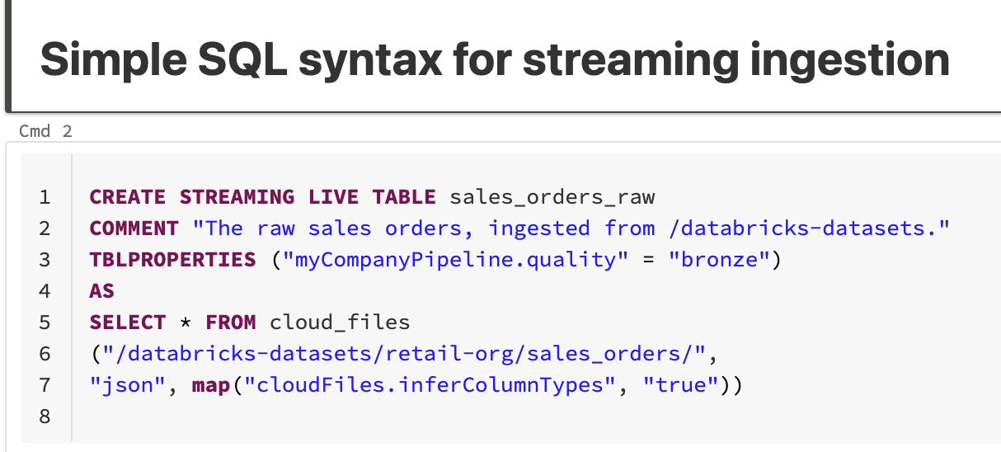
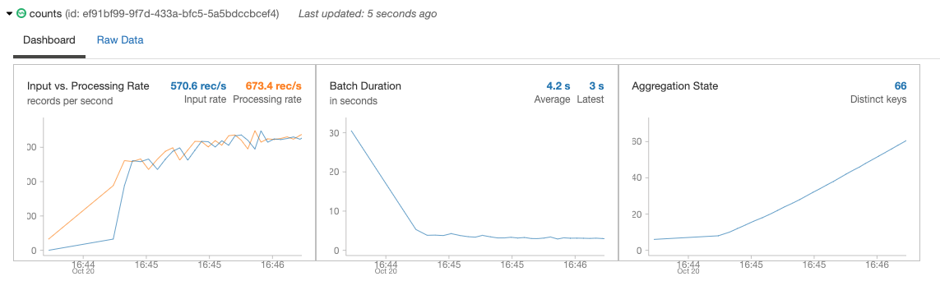
Continuous or scheduled data ingestion
Incrementally and efficiently process new data files as they arrive in cloud storage using Auto Loader
Automatically infer schema of incoming files or superimpose what you know with Schema Hints
Automatic schema evolution
Rescue data column - never lose data again
Schema Evolution
JSON
CSV
AVRO
PARQUET
✅
✅
✅
✅
Notes:
The first thing I wanted to talk about is getting data into Delta Lake. Ingesting data has to be reliable and has to scale. As volume grows, you need a way to ingest data easily, and with the ability to do change-data-capture, or CDC.
Auto Loader incrementally and efficiently processes new data files as they arrive in cloud storage. Auto Loader provides a Structured Streaming source called cloudFiles. Given an input directory path on the cloud file storage, the cloudFiles source processes new files with the option of also processing existing files in that directory.
Auto Loader can also infer schemas automatically, as well as evolve schemas dynamically by detecting the introduction of new columns to your data so you don’t have to manage the tracking and handling of schema changes yourself.
Auto Loader can also “rescue” data that was unexpected (for example, of differing data types) and set it aside so that you can choose to access it later.
Right now, schema evolution & inference is supported for JSON and CSV and Parquet data
---------------
The first thing I wanted to talk about is getting data into Delta Lake. Ingesting data has to be reliable and has to scale. As volume grows, you need a way to ingest data easily, and with the ability to do change-data-capture, or CDC.
Auto Loader incrementally and efficiently processes new data files as they arrive in cloud storage. Auto Loader provides a Structured Streaming source called cloudFiles. Given an input directory path on the cloud file storage, the cloudFiles source new files with the option of also processing existing files in that directory.
Auto Loader can also infer schemas automatically, as well as evolve schemas dynamically by detecting the introduction of new columns to your data so you don’t have to manage the tracking and handling of schema changes yourself. Auto Loader can also “rescue” data that was unexpected (for example, of differing data types) and set it aside so that you can choose to access it later.
Right now, we have support for JSON and CSV data, where you can infer the schema of all the files, as well as automatically evolve the schema of all your downstream Delta Tables. And we're bringing that same support to the data sources of PARQUET and AVRO later this year.

Slide 13

Change data capture (CDC)
Stream change records (inserts, updates, deletes) from any data source supported by DBR, cloud storage, or DBFS
Simple, declarative “APPLY CHANGES INTO” API for SQL or Python
Handles out-of-order events
Schema evolution
SCD2 support
Data Sources
Streaming Sources
Cloud Object Stores
Structured Data
Unstructured Data
Semi-
structured data
Data Migration Services
UPSERT via CDC
UPSERT via CDC
UPSERT via CDC
Bronze
Silver
Notes:
Lets talk about stream processing and change data capture
Delta Live Tables can ingest data from any data source that Databricks Runtime directly supports, any file in cloud storage such as Azure Data Lake Storage, AWS S3, or Google Cloud Storage, or any file stored in DBFS.
Change data capture are- streams of insert, update, and delete events representing incremental updates to some original table.
Now - previously - in Structured Streaming - the best solution for ingesting change data capture is the MERGE INTO command, but this has significant usability challenges, especially when the source is a streaming set of changes. A canonical example requires as many as 300 lines of complex Scala code to handle sequencing and event reconciliation. In practice, many users cannot build a fully functional solution without extensive help from Databricks field engineers.
Delta Live Tables includes functionality to make change data capture seamless. The functionality includes:
- a new, declarative API that lets users perform streaming CDC to a given target Delta table. Users can specify which row in the target should be inserted or updated by specifying a composite primary key as well as supply conditions for when to delete rows.
- Ordering is handled implicitly. Events can arrive out of order, but the final result should be the same as if they were applied in the correct order, based on a user specified sequencing column.
- We also include support for partial Updates: Some systems produce change records that contain only a subset of the fields in the target tabl, and unmodified columns are represented as NULLs. Delta Live Tables can coalesce these partial updates into a single complete / up-to-date row.
- DLT also handled schema Evolution: Users should not need to write complicated DDL to evolve the schema of the target table. Instead columns should automatically be added to the target table, even for complex / nested schemas.
Customers who have used DLT tell us that the simplicity it offers is one of the main reasons why they plan to adopt it widely in their organization.
------------------------
Delta Live Tables can ingest data from any data source that Databricks Runtime directly supports, any file in cloud storage such as Azure Data Lake Storage, AWS S3, or Google Cloud Storage, or any file stored in DBFS.
One prevalent source of incoming data is change data capture--streams of insert, update, and delete events representing incremental updates to some original table.
Now - in Structured Streaming - the best solution for ingesting change data capture is the MERGE INTO command, but this has significant usability challenges, especially when the source is a streaming set of changes. A canonical example requires as many as 300 lines of complex Scala code to handle sequencing and event reconciliation. In practice, many users cannot build a fully functional solution without extensive help from Databricks field engineers.
Delta Live Tables includes functionality to make change data capture seamless. The functionality includes:
- a new, declarative API that lets users perform streaming CDC to a given target Delta table. Users can specify which row in the target should be inserted or updated by specifying a composite primary key as well as supply conditions for when to delete rows.
- Ordering is handled implicitly. Events can arrive out of order, but the final result should be the same as if they were applied in the correct order, based on a user specified sequencing column.
- We also include support for partial Updates: Some systems produce change records that contain only a subset of the fields in the target table. Unmodified columns are either null or are not present in a given source. Delta Live Tables can coalesce these partial updates into a single complete / up-to-date row.
- DLT also handled schema Evolution: Users should not need to write complicated DDL to evolve the schema of the target table. Instead columns should automatically be added to the target table, even for complex / nested schemas.
Customers who have used DLT tell us that the simplicity it offers is one of the main reasons why they plan to adopt it widely in their organization.

Slide 14
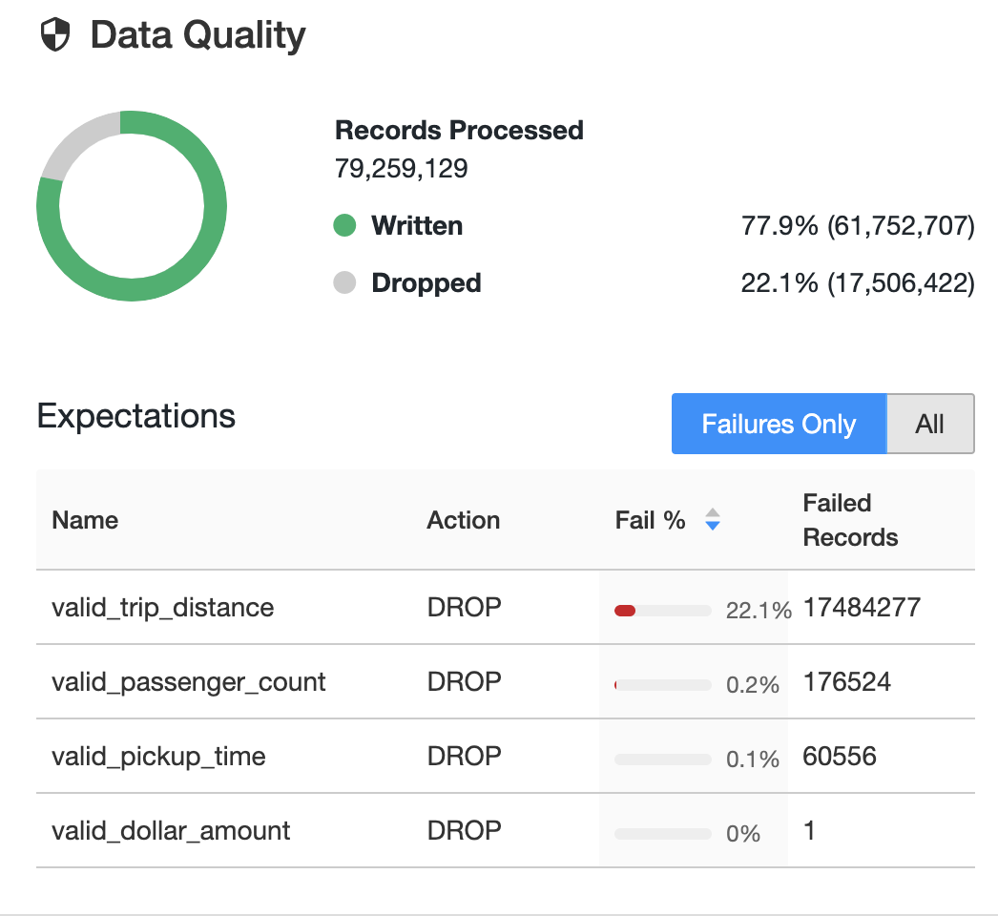
Data quality validation and monitoring
Define data quality and integrity controls within the pipeline with data expectations
Address data quality errors with flexible policies: fail, drop, alert, quarantine(future)
All data pipeline runs and quality metrics are captured, tracked and reported
/* Stage 1: Bronze Table drop invalid rows */
CREATE STREAMING LIVE TABLE fire_account_bronze AS
( CONSTRAINT valid_account_open_dt EXPECT (acconut_dt is not null and (account_close_dt > account_open_dt)) ON VIOLATION DROP ROW
COMMENT "Bronze table with valid account ids"
SELECT * FROM fire_account_raw ...
Notes:
The other reason why customers choose DLT is because of it’s differentiated data quality capabilities.
Data quality remains a huge problems for most customers who manage data pipelines.
Customers tell us that their organization suffers from low trust in their data. And data engineers struggle to quickly identify data quality issues before they make their way into reports and ML models, and when they do discover quality issues, it’s hard to correlate the problems back up to the data producer to fix data at the source.
To solve these problems, DLT includes first class support for data quality management and monitoring tools using a feature called Expectations.
Expectations helps prevent bad data from flowing into tables, lets your measure data quality, and provide tools to troubleshoot bad data.
You use expectations to define data quality constraints on the contents of a dataset. An expectation consists of a description, an invariant, and an action to take when a record fails the invariant. You apply expectations to queries using Python decorators or SQL constraint clauses.
DLT supports the ability to configure flexible policies on expectations. You are able to
Retain the row but log an error
Drop the row so it doesn’t end up in the target table
Or halt the entire pipeline. When a pipeline fails because of an expectation violation, you must fix the pipeline code to handle the invalid data correctly before re-running the pipeline.
DLT provides monitoring UIs that provide run-time statistics like number of rows process, failed, as well as metrics on a per-expectations basis. You can also look at historical performance (previous runs) with a click of a button - allowing you to track pipeline performance and data quality over time.
Some customers also use expectations as a way to do data exploration and classification of a new data set. For example your can use expectation to determine the % of values in a particular column are NULL, measure the number of invalid emails address, and more.
-----------
The other reason why customers choose DLT is because of it’s differentiated data quality capabilities. Data quality remains a huge problems for most customers who manage data pipelines.
Customers tell us that their organization suffers from low trust in their data. And data engineers struggle to quickly identify data quality issues before they make their way into reports and ML models, and when they do discover quality issues, it’s hard to correlate the problems back up to the data producer to fix data at the source.
To solve these problems, DLT includes first class support for data quality management and monitoring tools using a feature called Expectations. Expectations helps prevent bad data from flowing into tables, lets your measure data quality, and provide tools to troubleshoot bad data.
You use expectations to define data quality constraints on the contents of a dataset. An expectation consists of a description, an invariant, and an action to take when a record fails the invariant. You apply expectations to queries using Python decorators or SQL constraint clauses.
Use the expect, expect or drop, and expect or fail expectations with Python or SQL queries to define a single data quality constraint. You can define expectations with one or more data quality constraints in SQL or Python pipelines.
New, improved UIs for DLT monitoring UIs provide detailed view into the run-time stats of a DLT pipeline. Historical performance (previous runs) can be accessed with a click of a button allowing users to track pipeline performance and data quality over time.
Some customers also use expectations as a way to do data exploration and classification of a new data set. For example your can use expectation to determine the % of values in a particular column are NULL, measure the number of invalid emails address, and more.

Slide 15
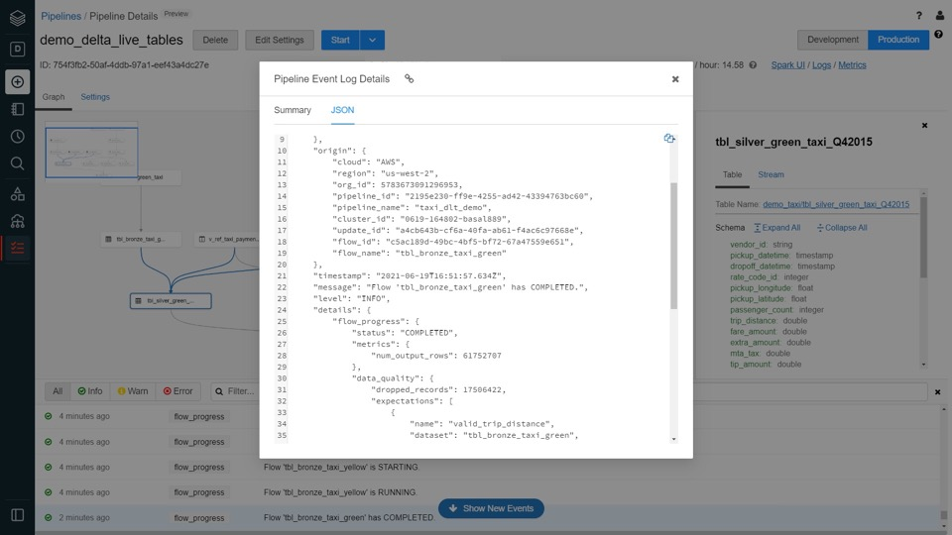
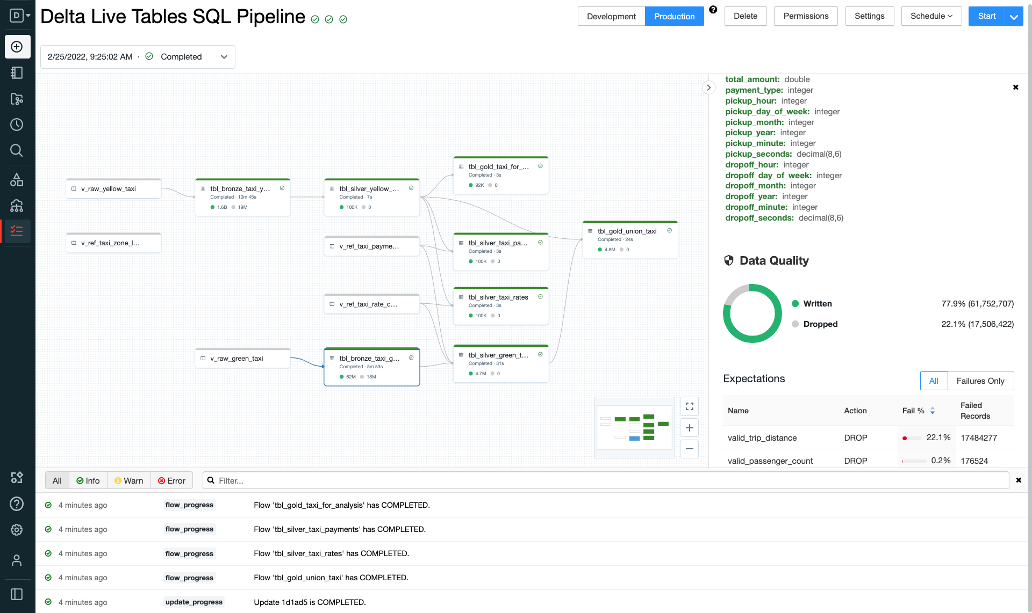
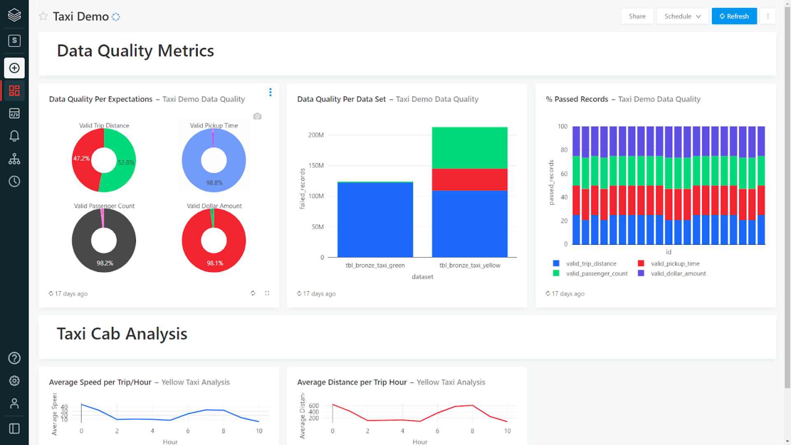
Data pipeline observability
High-quality, high-fidelity lineage diagram that provides visibility into how data flows for impact analysis
Granular logging for operational, governance, quality and status of the data pipeline at a row level
Continuously monitor data pipeline jobs to ensure continued operation
Notifications using Databricks SQL
Notes:
In addition to providing tools to track and enforce data quality at the table level, Delta Live Tables provides powerful pipeline observability
so you get a high-fidelity lineage diagram of your pipeline, track dependencies, and aggregate data quality metrics across all of your pipelines.
DLT emits all pipeline logs to a predefined Delta Lake table in the pipeline’s Storage Location, which can be used for monitoring, lineage, and data quality reporting. Because DLT logs are exposed as a Delta table, and the log contains data expectation metrics, it is easy to generate reports to monitor data quality with your BI tool of choice.
For example you can calculate metrics on the percentage of failures, number of rows processed, and more.
In addition to metrics, the logs include information to manage data governance including 1/ logging of all the operations in the pipeline and 2/ dependencies between pipelines and tables.
To query and visualize the event log, we recommend using Databricks SQL as it is tightly integrated with Delta and the Databricks platform and provides extremely fast query speeds via easy to manage compute endpoints.
You can also set up simple email alerts on data quality metrics with Databricks SQL -- for example you can be alerted when the % of failed rows in a particular table exceeds a use-defined threshold. Over time we will enhance ways to notify you of issues and also integrate with your favorite operational monitoring tools.
---------
In addition to providing tools to track and enforce data quality at the table level, Delta Live Tables provides powerful pipeline observability so you get a high-fidelity lineage diagram of your pipeline, track dependencies, and aggregate data quality metrics across all of your pipelines.
To make this work: DLT emits all pipeline logs to a predefined Delta Lake table in the pipeline’s Storage Location, which can be used for monitoring, lineage, and data quality reporting. Because DLT logs are exposed as a Delta table, and the log contains data expectation metrics, it is easy to generate reports to monitor data quality with your BI tool of choice. For example you can calculate metrics on the percentage of failures, number of rows processed, and more. In addition to metrics, the logs include information to manage data governance including 1/ logging of all the operations in the pipeline and 2/ dependencies between pipelines and tables.
To query and visualize the event log, we recommend using Databricks SQL as it is tightly integrated with Delta and the Databricks platform and provides extremely fast query speeds via easy to manage compute endpoints. With Databricks SQL, you can also set up simple email alerts on data quality metrics, so for example you can be alerted when the % of failed rows in a particular table exceeds a use-defined threshold. Over time we will certainly build in better ways to notify you of issues and also integrate with your favorite operational monitoring tools.

Slide 16

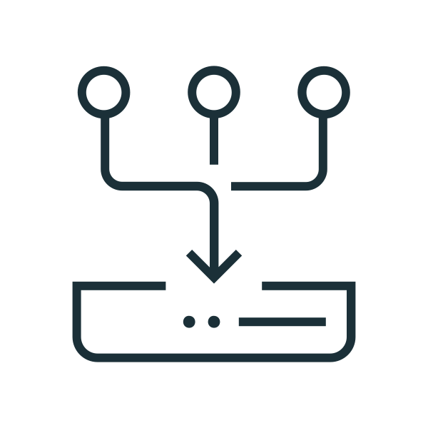

Automated ETL development lifecycle
Develop in environment(s) separate from production with the ability to easily test it before deploying - entirely in SQL
Deploy and manage environments using parameterization
Unit testing and documentation
Enables metadata-driven ability to programatically scale to 100s of tables/pipelines dynamically
Development
Lineage information captured and used
to keep data fresh anywhere
raw
Staging
clean
scored
Production
Notes:
Developing and testing data pipelines in a way that lets you catch issues early without impacting production is really hard.
The problem is that teams lack the tools to implement known software-best practices for developing and testing code.
For example: developing in an environment separate from production with the ability to easily test it before deploying it is really hard to do with just SQL and
Before DLT - teams had to build entire frameworks on top of their SQL to handle the parameterization of environments to implement these best practices.
DLT provides the needed framework to handle this. With DLT, you can parameterize your dependencies and make changes without affecting the production version of our pipelines.
This works by allowing the the Python and SQL code that defines your datasets to be parameterized by the pipeline’s settings.
Parameterization enables the following use cases:
Separating long paths and other variables from your code.
Reducing the amount of data that is processed in development or staging environments to speed up testing.
Reusing the same transformation logic to process from multiple data sources.
----------
Developing and testing data pipelines in a way that lets you catch issues early without impacting production is really hard. The problem is that teams lack the tools to implement known software-best practices for developing and testing code. For example: developing in an environment separate from production, and the ability to easily test it before deploying it, so that you can catch issues early without impacting end users. It’s quite hard to do with just SQL and as a result, teams had to build entire frameworks on top of their SQL to handle the parameterization of environments to implement these best practices.
DLT provides the needed framework to handle this. With DLT, you can parameterize your dependencies and make changes without affecting the production version of our pipelines. The Python and SQL code that defines your datasets can be parameterized by the pipeline’s settings. Parameterization enables the following use cases:
- Separating long paths and other variables from your code.
- Reducing the amount of data that is processed in development or staging environments to speed up testing.
- Reusing the same transformation logic to process from multiple data sources.

Slide 17
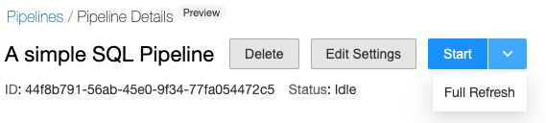
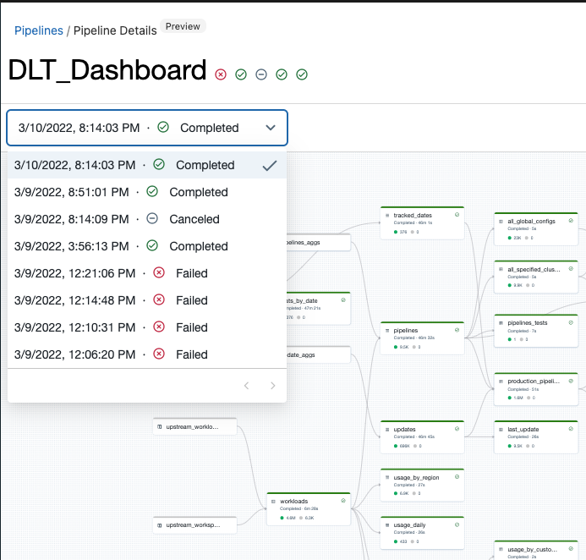
Automated ETL operations
Reduce down time with automatic error handling and easy replay
Eliminate maintenance with automatic optimizations of all Delta Live Tables
Auto-scaling adds more resources automatically when needed.
Notes:
Our goal with DLT is to abstract away resource management so data engineers can schedule tens or hundreds of pipelines without needing to think about infrastructure.
DLT automates operations and eliminates maintenance entirely
To better handle unexpected infrastructure failures, DLT automatically retries your pipelines when an operational issues is detected. We like to say that we hold the pager so you don’t have to.
Also - DLT automatically handles the storage maintenance tasks for you, including VACUUMing and other optimization activities to ensure you get the best possible performance.
------------
Sizing clusters for optimal performance given changing, unpredictable data volumes can be challenging and can lead to overprovisioning. Today, DLT automatically scales compute to meet performance SLAs by providing the user with the option to set the minimum and maximum number of instances and let DLT size up the cluster according to cluster utilization. This quarter we are implementing improvements to auto-scaling--in addition to looking at average cluster utilization to determine when to scale up,--we are improving our auto-scaling algorithms to also looking at the backlog of data -- so for example if you're pulling CDC data from Kafka, or Kinesis, or Delta -- we can determine the amount of data pending to be processed, and pass that information to the autoscaler to determine when to scale the cluster to ensure we meet latency SLAs - even in situations where CPU utilization is low. This will allow us to better meet your performance objectives.
Eventually we want to abstract away all of the resource management behind the scenes. So, the data engineers can schedule tens or hundreds of different pipelines, all in a single cluster. By doing the resource management to multiplex those flows, we can do a better job of optimizing infrastructure resources, provide instant compute, and auto-scale based on the incoming data volume.
In addition to auto-scaling, we hold the pager so you don’t have to. DLT automatic handles errors and automatically retries your pipeline run if an issues is detected. DLT also handles all of the optimization tasks for you, including VACUUMing and other tasks to ensure that the physical layout of data is optimized for the best possible performance.

Slide 18

Enhanced Autoscaling
Save infrastructure costs while maintaining end-to-end latency SLAs for streaming workloads
Problem
Optimize infrastructure spend when making scaling decisions for streaming workloads
Built to handle streaming workloads which are spiky and unpredictable
Shuts down nodes when utilization is low while guaranteeing task execution
Only scales up to needed # of nodes
Backlog monitoring
Utilization monitoring
No/Small backlog
& low utilization
Scale
down
Streaming source
Spark executors
AWS | Azure | GCP
Generally Available | Generally Available | Public Preview GA Coming Soon
Notes:
* We believe that by doing the resource management for you, we can be constantly improving our infrastructure utilization to provide you with the best performance at the lowest cost.
For example - sizing clusters manually for optimal performance given changing, unpredictable data volumes - particularly for streaming workloads - can be challenging and can lead to overprovisioning.
* DLT’s Enhanced autoscaling algorithm - currently in preview - improves upon the standard Jobs autoscaling to more efficiently handle streaming workloads by:
- shutting down nodes when utilization is low while guaranteeing tasks complete successfully
- only scale up to the nodes needed, even if this is lower than the max amount authorized by the user
We are currently previewing autoscaling with a number of customers.
AWS
Public Preview - current
GA - Q3 FY23
AWS GovCloud
tbd
Azure
Public Preview - current
GA - Q3 FY23
Azure Government
tbd
Azure Mooncake (CHINA)
tbd
GCP
Public Preview - current
GA - Q3 FY23

Slide 19

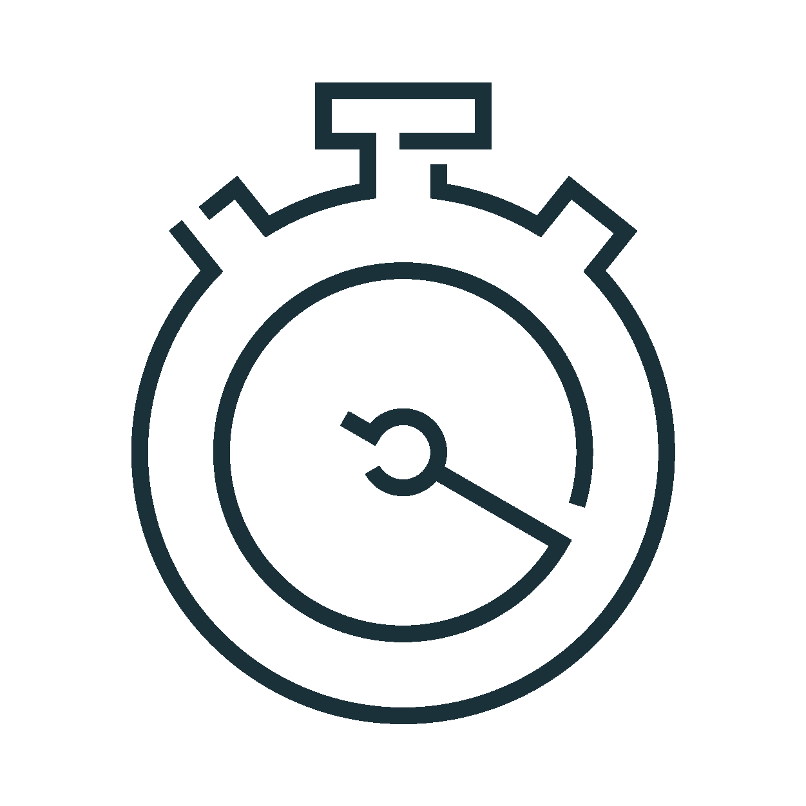

Introducing Enzyme
An automatic optimizer for incremental ETL
Monotonic Append
Delta Tracked
Changes
Partition Recompute
Cost Model
MERGE Updates
Optimal
Update
Technique
Query Plan
Analysis
Full Recompute
+ Catalyst Query Optimizer

Slide 20
Delta Live Tables Best Practices
Declarative Approach: DLT uses a declarative approach to building reliable data pipelines. This allows you to focus on defining the transformations to perform on your data, while DLT manages task orchestration, cluster management, monitoring, data quality, and error handling.
Unified API for Batch and Streaming: DLT supports both batch and streaming data processing with a single API. This simplifies the development process and allows for flexibility in handling different types of data workloads.
Automated Infrastructure Management: DLT automatically manages your infrastructure at scale. This reduces the need for manual intervention and allows data analysts and engineers to focus on extracting value from data.
Support for SQL and Python: DLT supports both SQL and Python, providing flexibility in how you define your data flows.
Integration with Databricks Lakehouse: DLT is fully integrated into Databricks Lakehouse. This allows you to schedule pipelines with a single click or set them to ‘continuous’ mode to automatically ingest new data as it arrives.
Granular Pipeline Observability: DLT provides granular pipeline observability, offering a high-fidelity lineage diagram of your pipeline, tracking dependencies, and aggregating data quality metrics across all of your pipelines.
Parameterization of Environments: DLT provides a framework for parameterizing environments. This is particularly useful for implementing best practices in software engineering, such as developing in an environment separate from production, the ability to easily test it before deploying, and the ability to deploy and manage environments using parameterization, unit testing, and documentation.
Materialized Views: DLT supports the use of Materialized Views to speed up the performance of data processing and reporting.
Integration with Unity Catalog: The integration of DLT with Unity Catalog can help streamline and automate data governance for DLT pipelines.
Development in Separate Environments: DLT enables modern software engineering best practices like the ability to develop in environment(s) separate from production, the ability to easily test it before deploying, and the ability to deploy and manage environments using parameterization, unit testing, and documentation.

Slide 21
Streaming capability

Slide 22
What is Streaming?

Slide 23
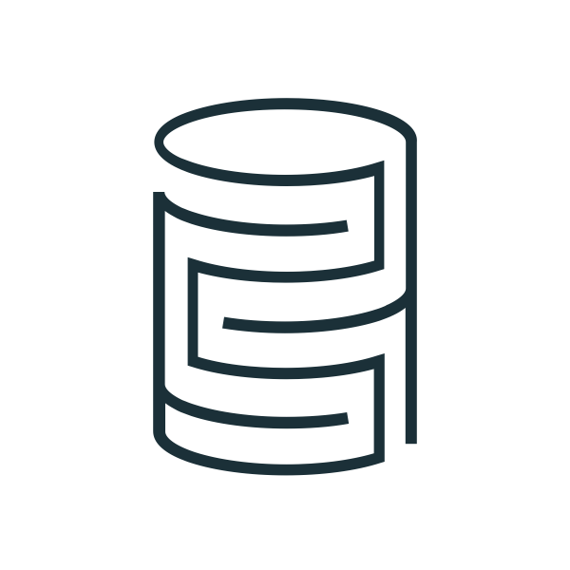





Continuously generated and unbounded data
Streaming Data
DB Change Data Feeds
Clickstreams
Machine & Application Logs
Application Events
Mobile & IoT Data
The vast majority of the data in the world is streaming data!
Notes:
The key definition of streaming data is “continuous” and “unbounded”.
Here are a few examples, which should lead to the realization that most of the data in the world is streaming data.

Slide 24


Stream Processing
Data Source
Processing
Traditional Processing is
one-off and bounded
1
2
Data Source
Processing
Stream Processing is continuous and unbounded
Notes:
Traditional processing loads data into a storage location to create artificial boundary, and then processes the bounded data in a one-off manner. This is a two-step process.
Stream processing continuously processes unbounded data as it is generated from data sources.

Slide 25










New opportunities from real-time data
Every organization generates vast amounts of real-time data
Creating opportunities for new kinds of real-time applications
Transactional records
Point of sale (POS)
Banking transactions
Airline reservations
Call center records
Third-party
News feeds
Weather
Market data
Real-time traffic
Fraud detection
Personalized offer
Vaccine distribution
Smart pricing
In-game analytics
Connected cars
and smart devices
Interactions
Web clicks
Social posts
Emails
Instant messages
IoT events
Sensors
Geolocation
Machine logs
Mobile devices
Predictive maintenance
Content recommendations
Notes:
In the last few years we have seen an explosion of real time data. Constantly generated by every individual, every machine and every organization on the planet. From transactions in operational systems to customer and employee interactions, to 3rd party data services in the cloud and IoT data from sensors and devices. Real time data is everywhere.
All this real time data creates new opportunities to build innovative real-time applications to detect fraud, provide personalized offers to customers, dynamically adjust pricing in real-time and predict when a machine or part is going to fail and much more.

Slide 26



Data streaming is hard for most organizations
New APIs and languages to learn
Complex operational tooling to build
Real-time and historical data in separate systems
Difficult to enable existing data teams with the languages and tools they already know
Difficult to deploy and maintain streaming data pipelines that run reliably in your production environment
Incompatible governance models limit ability to control access for the right users and groups
Notes:
Well, its because data streaming is really hard for most organizations.
It involves learning new languages and new APIs associated with specialized technologies and data platforms. This makes it extremely difficult for existing data practitioners to work with streaming data using the tools and languages they already know.
It involves building complex operational tooling and stitching together different services to perform tasks such as monitoring and data quality testing, recovery and restart from failure, infrastructure scaling and more. This makes it incredibly difficult to deploy and maintain trusted, reliable, and efficient data streaming pipelines in your production environment.
Finally, real-time data is typically in a separate system from historical data which makes it really hard to govern and share data consistently in one place.
—-----------
In addition to new API and languages, there is also complex operational tooling that needs developing before streaming data pipelines are ready for production including
Real time data quality monitoring and exception handling procedures
Processes to automatically recover pipelines from failure and restart them correctly
Capabilities to autoscale the underlying infrastructure for each unique workload
The impact of all this manual development this is that production data pipelines become difficult to manage and unreliable over time.
To make matters even more complex real-time data is typically separate in a separate system from historical data such as a message queue. This create a governance issues:
Giving the right access to the right users across batch and streaming data together
Making real-time and historical data discoverable for the entire organization
Exposing the full lineage for every data pipeline

Slide 27

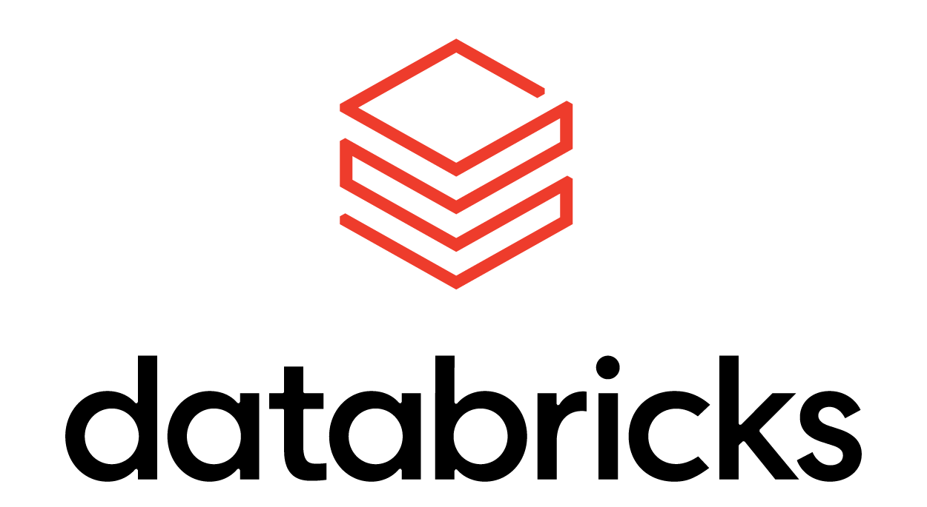
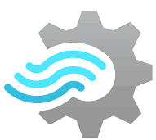

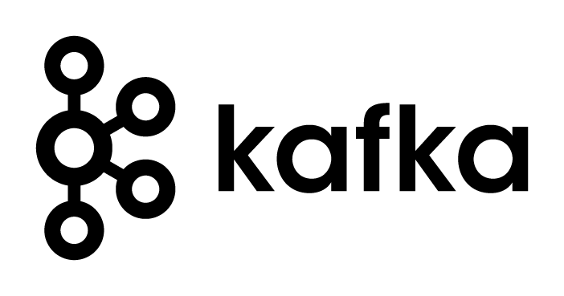


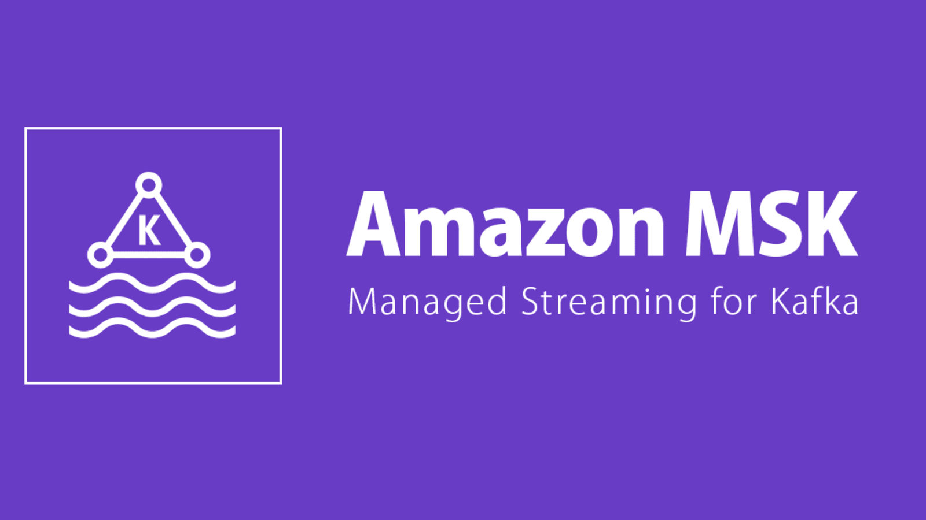

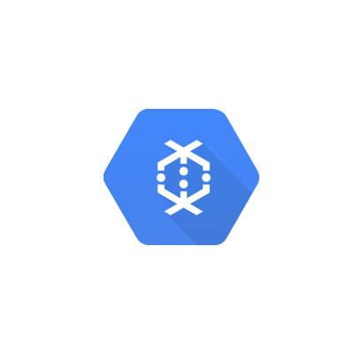



Streaming Technologies
Capturing
Processing
Amazon Kinesis Data Streams
Azure Stream Analytics
Azure Event Hubs
Amazon MSK
Amazon Kinesis Data Analytics
Google Cloud Dataflow
Google Cloud Pub/Sub
Notes:
Streaming capturing systems are used to capture and temporarily store streaming data for processing. Sometimes these systems are also called messaging systems or messaging buses.
Streaming processing systems are used to continuously process data from streaming capturing systems and other storage systems (e.g. Delta Lake).

Slide 28

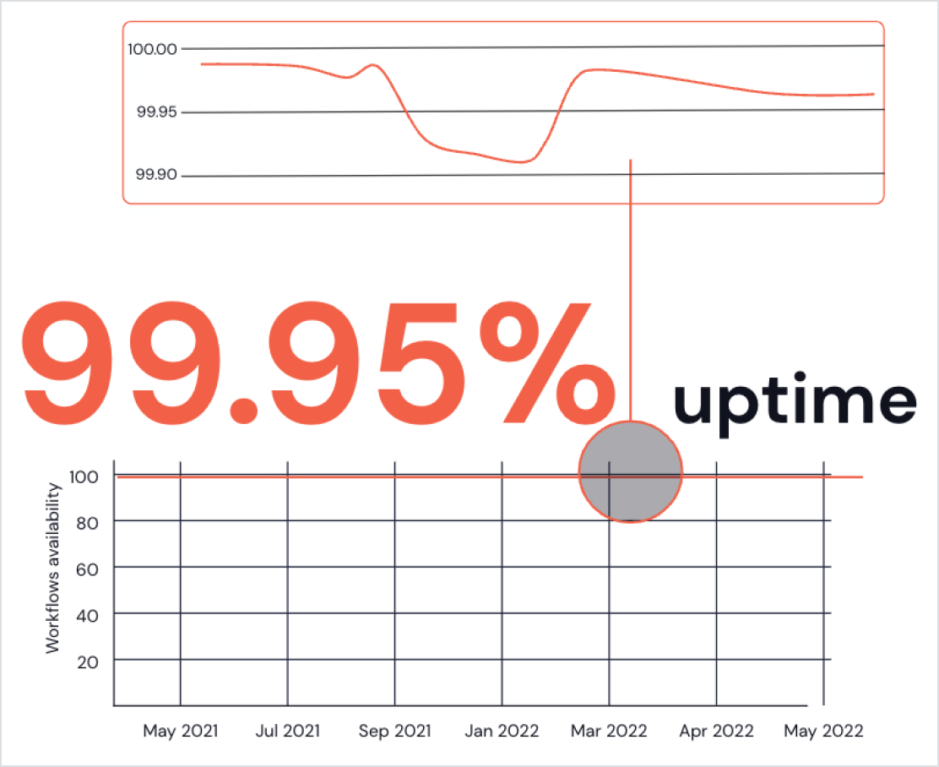




Spark Structured Streaming
Fast and reliable stream processing for real-time applications
Unified batch & streaming APIs
Lets developers use the same business logic across batch and stream processing
Fault tolerance & recovery
Automatic checkpointing & failure recovery allowing for reliable operations
Performance | Throughput
Handles > 14M events/sec (1.2T events per day) for the most challenging workloads
Flexible operations
Arbitrary logic and operations on the output of a streaming query
Stateful processing
Support for stateful aggregations and joins along with watermarks for bounded states
Notes:
At the core of data streaming on the Lakehouse Platform is Structured Streaming a wildly popular open source project that is already powering thousands of real-time applications today. With the Databricks Lakehouse platform you get Spark Structured Streaming as a managed service which has an incredible track record of 99.95% uptime. Here are 5 more reasons it is so popular.
Unification - The foremost advantage of Structured Streaming is that it uses the same API as batch processing,, making the transition to real-time processing from batch much simpler.
Fault Tolerance & Recovery - Structured Streaming checkpoints state automatically at every stage of processing. When a failure occurs, it automatically recovers from the previous state. The failure recovery is very fast since it is restricted to failed tasks as opposed to restarting the entire streaming pipeline in other systems.
Performance - Structured Streaming provides very high throughput with seconds of latency at a lower cost, taking full advantage of the performance optimizations in the Spark SQL engine..
Flexible Operations - The ability to apply arbitrary logic and operations on the output of a streaming query using foreachBatch. This enables developers to perform operations like upserts, writes to multiple sinks, as well as interaction with external data sources. Over 40% of our users on Databricks take advantage of this feature.
Stateful Processing - Support for stateful aggregations and joins along with watermarks for bounded state and late order processing. In addition, arbitrary stateful operations with [flat]mapGroupsWithState backed by a RocksDB state store are provided for efficient and fault-tolerant state management (as of Spark 3.2).

Slide 29

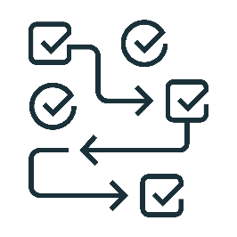


Delta Live Tables
Streaming data ingestion and transformation made simple
Accelerate ETL development
Declare SQL/Python and DLT automatically orchestrates the DAG, handles retries, changing data
CREATE STREAMING TABLE raw_data
AS SELECT *
FROM cloud_files(“/raw_data”, ”json”)
Automatically manage your infrastructure
Automates complex tedious activities like recovery, auto-scaling, and performance optimization
CREATE LIVE TABLE clean_data
AS SELECT …
FROM LIVE.raw_data
Ensure high data quality
Deliver reliable data with built-in quality controls, testing, monitoring and enforcement
Unify batch and streaming
Get the simplicity of SQL with the freshness of streaming with one unified API
Notes:
Delta Live Tables (DLT) is the first ETL framework that uses a simple declarative approach to building reliable streaming and batch data pipelines and automatically managing your infrastructure at scale so data analysts and engineers can spend less time on tooling and focus on getting value from data. With DLT, engineers are able to treat their data as code and apply modern software engineering best practices like testing, error handling, monitoring and documentation to deploy reliable pipelines at scale.
Accelerate ETL development:
Unlike solutions that require you to manually hand-stitch fragments of code to build end-to-end pipelines, DLT makes it possible to declaratively express entire data flows in SQL and Python.
In addition, DLT natively enables modern software engineering best practices like the ability to develop in environment(s) separate from production, the ability to easily test it before deploying, deploy and manage environments using parameterization, unit testing and documentation. As a result, you can simplify the development, testing, deployment, operations and monitoring of ETL pipelines with first-class constructs for expressing transformations, CI/CD, SLAs and quality expectations, and seamlessly handling batch and streaming in a single API.
Automatically manage your infrastructure:
Sizing clusters for optimal performance given changing, unpredictable data volumes can be challenging and lead to overprovisioning. DLT automatically scales compute to meet performance SLAs by providing the user with the option to set the minimum and maximum number of instances and let DLT size up the cluster according to cluster utilization.
Error handling and recovery, and performance optimization are all handled automatically. With DLT, you can focus on data transformation instead of operations.
Ensure high data quality:
DLT makes it easy to create trusted data sources by including first-class support for data quality management and monitoring tools using a feature called Expectations.
Expectations help prevent bad data from flowing into tables, track data quality over time, and provide tools to troubleshoot bad data with granular pipeline observability so you get a high-fidelity lineage diagram of your pipeline, track dependencies, and aggregate data quality metrics across all of your pipelines.
Unified batch and streaming:
Unlike other products that force you to deal with streaming and batch workloads separately, DLT supports any type of data workload with a single API so data engineers and analysts alike can build cloud-scale data pipelines faster and without needing to have advanced data engineering skills.

Slide 30




Lakehouse Differentiations
Unified Batch and Streaming
Support All Personas
Optimal Cost Structure
End-to-End Streaming
No overhead of learning, developing on, and maintaining two sets of APIs and data processing stacks
Easily configure the right latency-cost tradeoff for each of your streaming workloads
Has everything you need, no need to stitch together different streaming technology stacks or tune them to work together
Provide diverse users with their favorite tools to work with streaming data, enabling the broader organization to take advantage of streaming
Notes:
The backbone of Lakehouse streaming, Spark Structured Streaming, was built with simplicity as its first principle. With that principle in mind, Structured Streaming and all of the Lakehouse streaming capabilities have a single and unified API for batch and stream processing. There is little to no new knowledge or skill to learn in order to adopt streaming on the Lakehouse.
The Lakehouse Platform provides diverse tools and interfaces for different personas. As a company develops and runs streaming workloads on the Lakehouse, there is no need for additional integration work in order for the entire organization to take advantage of streaming from everyone’s favorite tools and interfaces.
The Lakehouse Platform allows configurable processing frequency and size for each streaming workload so that a company can achieve the most optimal cost structure by making latency-cost tradeoffs at a workload granularity.
The Lakehouse is a well integrated end-to-end streaming platform. It provides out-of-the-box integrations with all popular message buses such as Apache Kafka, Kinesis, EventHub, etc. The foundational long-term storage system for the Lakehouse, Delta Lake, was built for streaming workloads from the beginning. Spark Structured Streaming is the processing engine that powers various streaming capabilities in the Lakehouse including Auto-Loader, Delta Live Tables, CDC, Materialized Views.

Slide 31



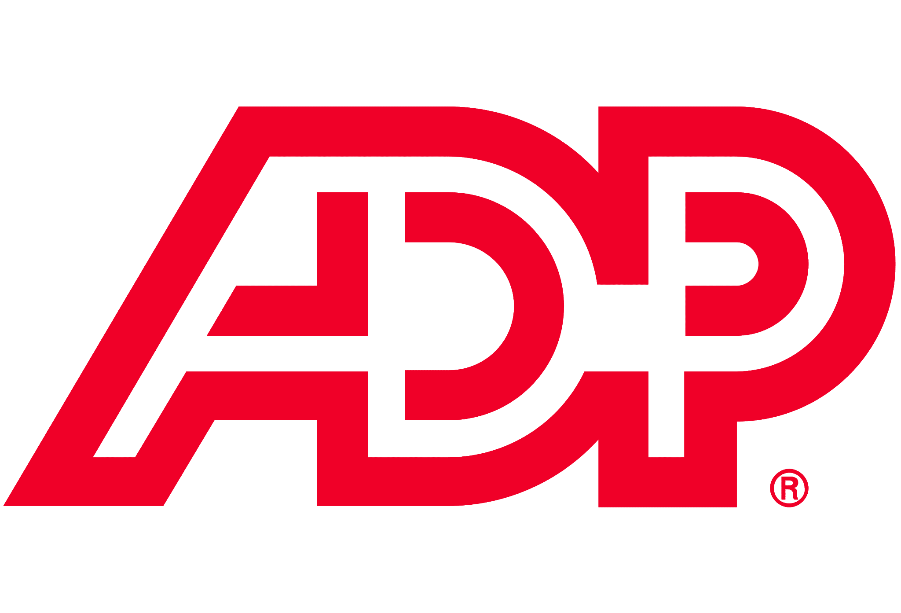





















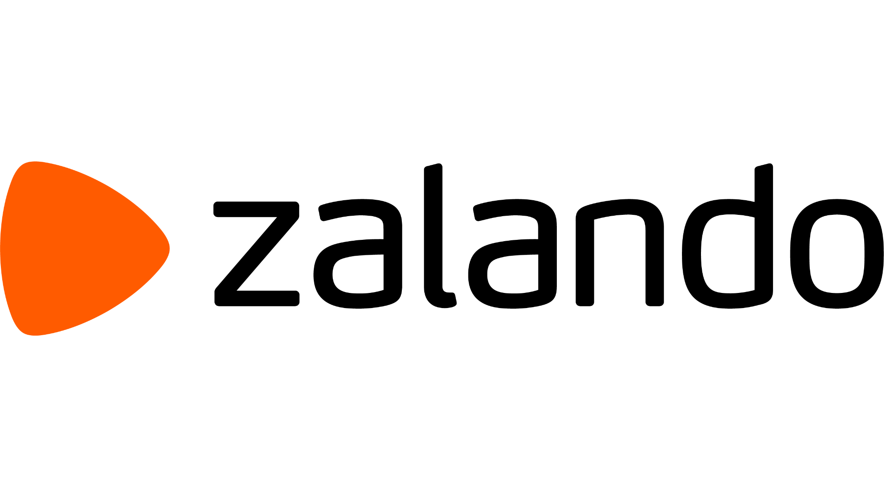




















Streaming customers in every industry
Software & Tech
Retail & CPG
Media & Entertainment
Financial Services
Utilities & Public Sector
Transportation & Logistics
Healthcare & Life Sciences
Notes:
Databricks has hundreds of customers that have successfully built and deployed real-time use cases across every industry.
Some big names and logos here that show we have a proven track record of success in the space.

Slide 32
Anatomy of a Stream

Slide 33
Structured Streaming Anatomy
source
spark.readStream.format("kafka|kinesis|socket|...")
.option(<>,<>)...
.load()
transformation
.select(cast("string").alias("jsonData"))
.select(from_json($"jsonData",jsonSchema).alias("payload"))
sink
.writeStream
.format("kafka")
.option("kafka.bootstrap.servers",...)
config
.trigger("30 seconds")
.option("checkpointLocation",...)
.start()
Notes:
APIs are very familiar - we’ve simply changed the API calls for reading and writing our data from spark.read, to spark.readStream, and spark.writeStream, and everything in between is more or less the same.
This is really valuable - instead of maintaining two separate code bases, and managing multiple complex distributed systems, you’re now able to build real time applications in a single, unified platform.

Slide 34
Sources

Slide 35



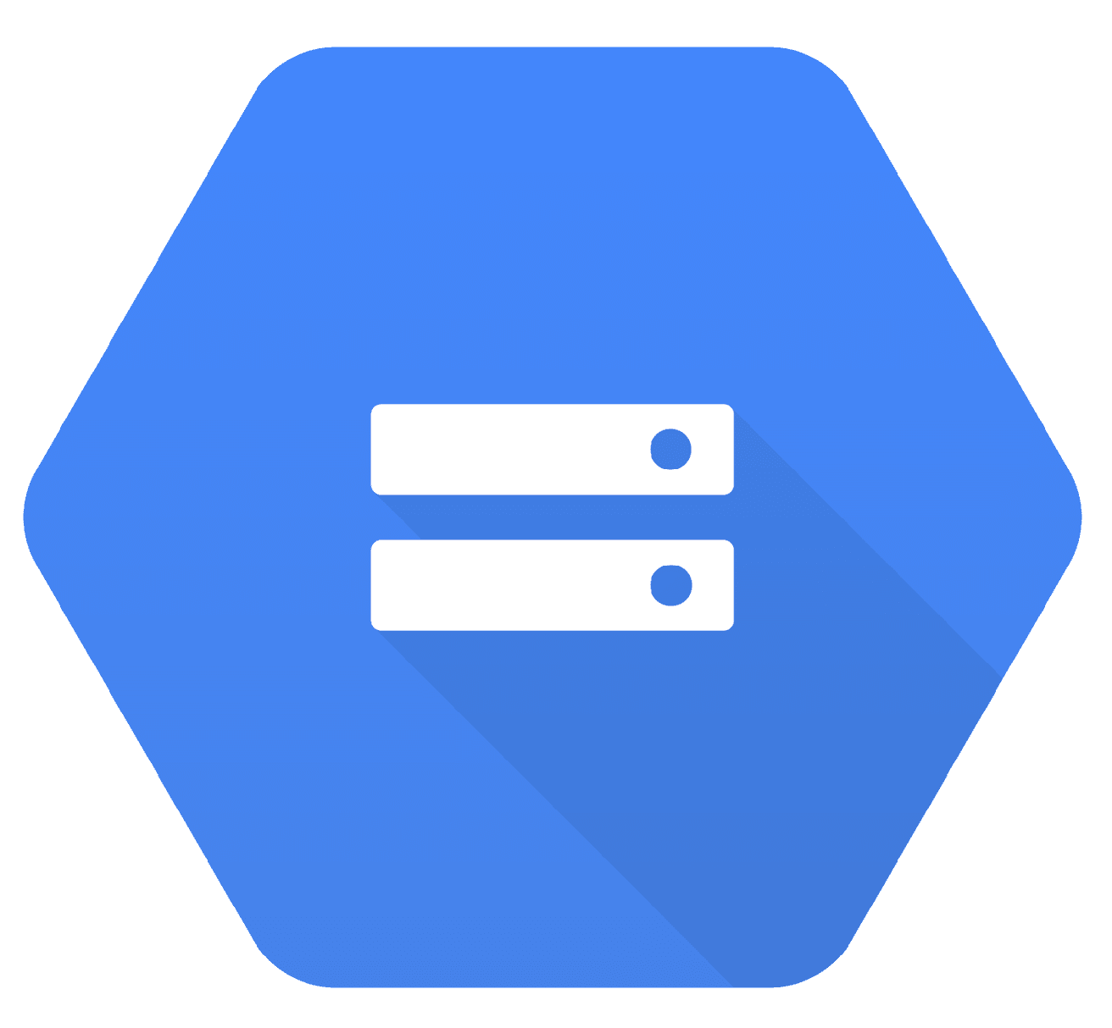

Streaming Ingestion
Messaging Stores
DB Change Data Feeds
Streaming Connectors
Clickstreams
Amazon MSK
Amazon Kinesis Data Streams
Azure Event Hubs
Google Cloud Pub/Sub
Machine & Application Logs
Object Stores
Application Events
Amazon S3
Azure Data Lake Storage
Google Cloud Storage
Auto Loader
Mobile & IoT Data
Notes:
We provide various streaming connectors that make it easier for you to ingest data from streaming capturing systems into Delta lake.
We provide Auto Loader that makes it easier for you to ingest data continuously and incrementally from cloud file storage systems into Delta lake.

Slide 36
Benefits of Auto Loader
No Custom Bookkeeping: Incrementally process new files as they land in object storage. You don’t need to manage any state information on what files arrived.
Scalable: Efficiently track the new files arriving by leveraging cloud notification and queue services without having to list all the files in a directory. Scalable to handle millions of files in a directory.
Easy to use: Automatically sets up cloud notification and queue services required.
Notes:
You’ll note that the outlined benefits here overlap with those of Structured Streaming, because SS is the foundation of this feature.
Auto Loader is recommended to simplify ingestion whenever data will be coming from object storage.
The big innovation is the ability to automatically configure and integrate with cloud notification and queue services to reduce total operating costs and more efficiently track which files need to be processed.

Slide 37
Transformations

Slide 38
Stream types
Stateless
Stateful
Filters
Projections
Joins with static data
Aggregations
Joins with streaming data
Deduplication
Arbitrary stateful operations

Slide 39
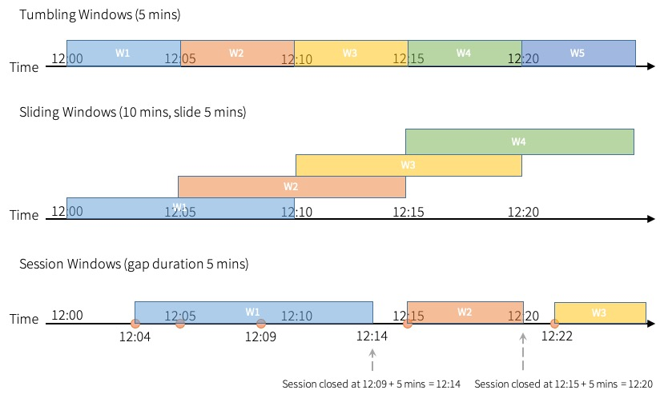
Windows for Streaming Aggregation
Provide easy syntax to get near real-time metrics on data as it’s processed
Fixed windows aggregate all events in a set period of time:
How many events per 10 minute block in a given hour
12:00-12:10, 12:10-12:20, 12:20-12:30
Sliding windows overlap:
How many events per 10 minute block starting every 2 minutes
12:00-12:10, 12:02-12:12, 12:04-12:14
Notes:
Because our data is unbounded, we cannot simply aggregate all records. Defining time-based windows allows streaming analytics and dashboarding against data as it’s processed.
Most streaming analytics are concerned with the event time, monitoring and reacting to trends in data as they occur.
Tumbling Windows
Windows do not overlap, but rather represent distinct buckets of time. Each event will be aggregated into only one window.
Sliding windows
The windows overlap and a single event may be aggregated into multiple windows.

Slide 40
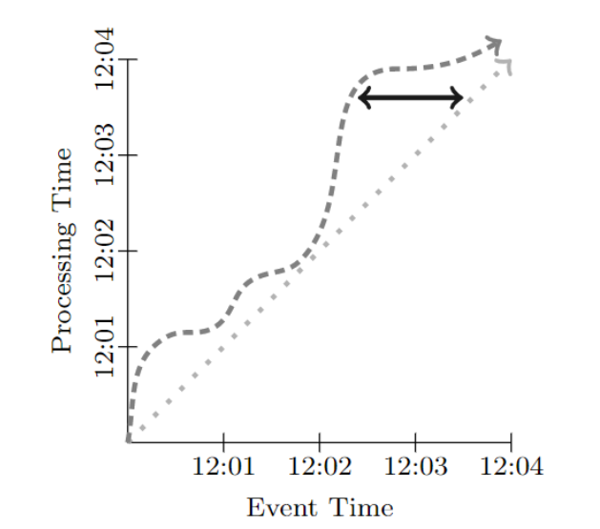
Event Time vs. Processing Time
Event Time
Time at which the event (record in the data) actually occurred.
Processing time
Time at which a record is actually processed.
Time Domain Skew
Notes:
Simply put: event time is when data was created, and processing time is when it is processed in Databricks.
With unbounded data, we need to be aware of these timestamps to ensure that the correct data is being processed (and that data is being processed correctly), because we don’t have the ability to sort our records before processing them (we process them in the order they arrive).
We expect time domain skew when batch processing:
Processing time per definition much later (e.g. an hour or day) than event time
Data assumed to be complete (or settle for incompleteness)
When we’re stream processing:
Processing time is usually only slightly greater than event time (e.g. seconds, minutes)
This presents a challenge when the processing time is much greater than the event time (late data): we’re not able to conclude anything easily
How long to wait for the data to be complete?

Slide 41
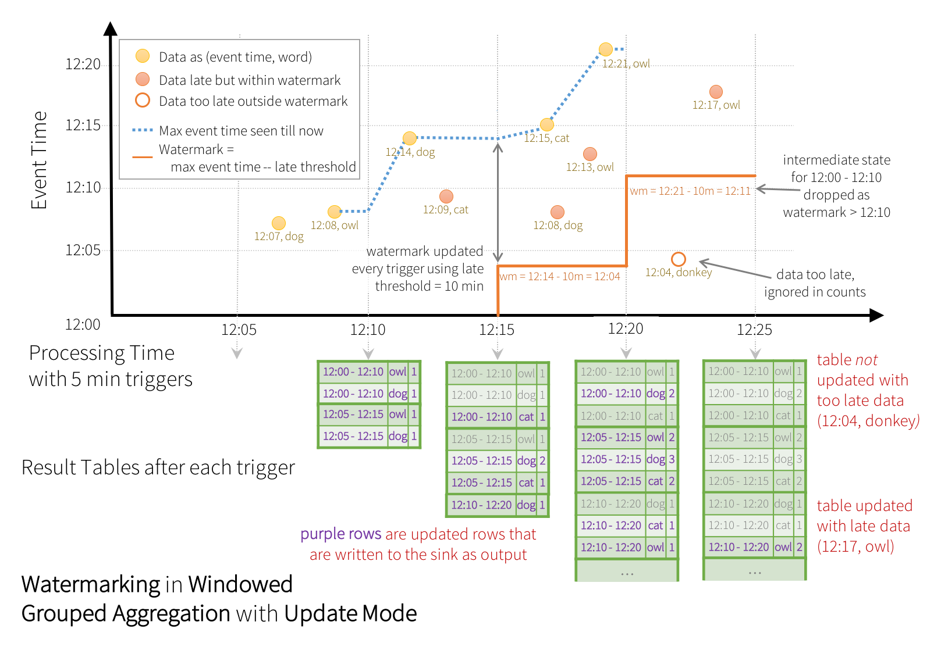
Late Data and Watermarking
Watermarks define how long we’ll continue to update each window
Late data arriving within this threshold will be used to update results
Late data arriving outside of this threshold will not be included in the windowed aggregation
Notes:
Watermarks define how long we’ll continue to update each window
Late data arriving within this threshold will be used to update results
Late data arriving outside of this threshold will not be processed.
Note that because of this potential omission of late-arriving data, aggregates processed in this way may benefit from re-processing to update final aggregates with complete data. However, in many streaming use cases we only care about data that is still current, hence the ability to ignore records that are arriving after significant delay.
Note that when results are written depends on the output mode; with complete and update, we’ll materialize results for each window from the time the window starts until the watermark passes. For append output, we’ll wait until the watermark has passed to write out the results (sacrificing latency for tolerance of late-arriving data).

Slide 42
Join types
Stream-static joins
Stream-stream joins
No state information is tracked
Support driven by the streaming table
Inner
Left Outer
Left Semi
For each microbatch of streaming records, join with static table
Conditionally supports most join types
Inner
Left
Right
Full
Left Semi
Need to specify watermark with time constraints for correct results and state cleanup

Slide 43
flatMapGroupsWithState Design
Breaking Down the Logic
Define data structures - what goes in, what is stored, what comes out.
Define initialization logic - what do you do when the state does not exist for a given key?
This will occur the first time the system receives a given key, or if the state management logic removes records from the state over time.
Define steady-state logic - what do you do when the state already exists for a given key or after initialization?
Define timeout logic - what do you do when no records have been received for a key?
This is optional. The correct thing to do when no records are received for a given key may be to do nothing at all.
Notes:
It comes down to defining four things

Slide 44
Sinks

Slide 45

Exactly-once guarantees
Source
Transformation
Sink
Trigger
Read from an initial offset position
Keep tracking offset position as processing makes progress
Apply the same transformations using a normal Dataframe
Write to a target
Keep updating checkpoint as processing makes progress

Slide 46
foreach() and foreachBatch() Sink
foreach()
Executed on the output data of every DataFrame record
foreachBatch()
Executed on the output data of every batch
Used for implementing arbitrary functions such as writing to messaging buses and making API calls to external services
At least once write guarantees - use batchId to dedupe and implement exactly once semantics

Slide 47
Configs

Slide 48
Trigger Types
Default: Process as soon as the previous batch has been processed
Fixed interval: Process at a user-specified time interval
One-time: Process all of the available data and then stop

Slide 49
Output Modes
Append (Default): Only new rows added to the result table since the last trigger will be output to the sink
Complete: The whole result table will be output to the sink after each trigger
Update: Only the rows updated in the result table since the last trigger will be output to the sink

Slide 50
Appending new data as it arrives
Works when new data is added and the query is monotonic
mon·o·ton·ic que·ry
/ˌmänəˈtänik ˈkwirē/
noun
A query that does not lose any tuples it previously made output, with the addition of new tuples in the database
Very efficient
Only works for select/project/inner join/etc
Does not handle changes to the input
date
city_id
date
city_id
city_name
2022-06-01
1
2022-06-01
1
Berkeley
2022-06-01
2
2022-06-01
2
San Francisco
2022-06-02
3
2022-06-02
3
Denver
Notes:
Frequency and cost of recomputation can become prohibitively expensive at large scales.
While users can easily express transformations using SQL or Dataframes, ETL pipelines need to frequently update (or recompute) their tables produced by ETL. The frequency and cost of recomputation can become prohibitively expensive at large scales.
We are building Enzyme to reduce the cost of keeping these tables up to date. Enzyme is a new optimization layer designed specifically to speed up the process of doing ETL. Enzyme can create and efficiently keep up-to-date a materialization of the results of a given query stored in a Delta table. Enzyme does this by using a cost model to choose between a variety of techniques that borrow from traditional literature on the maintenance of materialized views, delta-to-delta streaming, and manual ETL patterns commonly used by our customers.

Slide 51
Partition recomputation
Split the table into partitions and only recompute ones that change
PARTITION BY date
PARTITION BY date
Able to handle aggregations and updates
Requires the input and output to have the same partitioning
date
amount
date
sum
2022-06-01
$10
2022-06-01
$56
2022-06-01
$46
2022-06-02
$324
2022-06-02
$348
2022-06-02
$24
2022-06-03
$32
2022-06-03
$50
2022-06-03
$67
$18
2022-06-03
$15
2022-06-03
$20

Slide 52
MERGE updates to specific rows
Use techniques from databases literature to compute changes to results
Able to handle complicated queries
Able to handle updates/inserts/deletes
Merge is expensive
Complicated to reason about
date
amount
2022-06-01
$10
2022-06-01
$46
date
sum
2022-06-02
$324
2022-06-01
$56
2022-06-02
$24
2022-06-03
+17
2022-06-02
$348
2022-06-03
$32
2022-06-03
$50
2022-06-03
$67
2022-06-03
$18
$15
2022-06-03
$20

Slide 53
Streaming Best Practices
Use a Declarative Approach: Choose a trigger interval over nothing at all. This helps control Storage Transaction API cost. For example, .trigger(processingTime='5 seconds').
Infrastructure Management: You can use Amazon S3 which provides a robust and simple object storage service.
Instance Family Choices: For AWS, c5 instances are suitable for map-heavy streams, c5d for multiple streams or when spill space is needed, m5 for streams that join tables or do aggregations, i3 for streams with big joins/aggregations, and r5d is a good choice considering the spot market. Please consult with your Solutions Architect for specific workloads.
Use RocksDB: If there are stateful transformations, use RocksDB. Use proper watermarking to have control over state store size.
Delta Merge: If there is a deduplicate requirement, use delta merge approach over drop duplicate to avoid state store ops.
Optimization: For latency-sensitive streaming, use the below parameters and a scheduled daily optimize job.
spark.databricks.io.cache.enabled true
delta.autoOptimize.optimizeWrite = false
delta.autoOptimize.autoCompact = false
Multiplexing: Multiplexing on the same cluster is not recommended. It's difficult to debug jobs like this, but it saves on cost. However, if the streaming workload has inconsistent data volumes (small => large => small) throughout the day, Delta Live Tables (DLT) has streaming autoscaling for that exact use case.

Slide 54

Job logging details and DB workflow

Slide 55


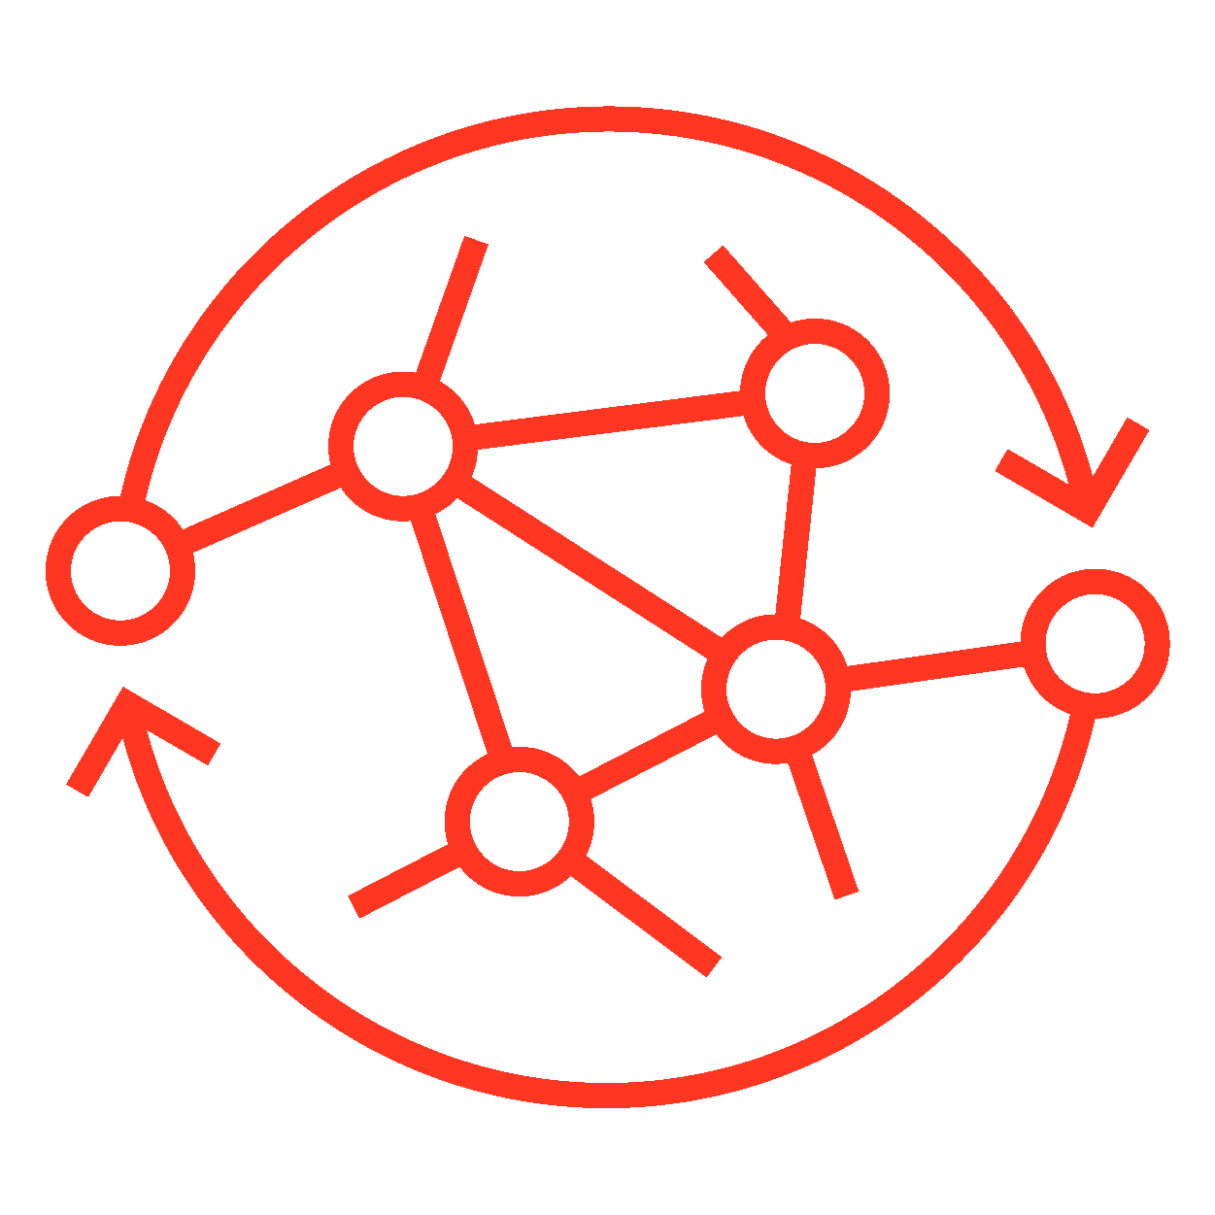

Modern data engineering requires modern data orchestration
Complex, multi-stage data flows
Multiple use cases
Orchestrating processes across all data, analytics and AI use cases is business critical
Extract, transform, load
“Data pipelines are growing in size, volume, and complexity, with multistage processing and dependencies between various data assets.”*
BI dashboard refresh
Multiple data sources & triggers
Machine learning Model training
*Gartner Data Engineering Essentials, Patterns and Best Practices, September 2022
Real-time applications
Multiple dependencies
Notes:
Data is becoming and increasingly important differentiator for companies with the analytics and AI capabilities it provides to organizations. As the use of data becomes ubiquitous and more sophisticated, so grows the complexity of the data pipelines that enable these new uses of data in the organization. This
This trend, called out by Gartner, of increased complexity of processes is rooted in these factors:
Multiple, varied data sources including streaming
Complexity of multi-step data flows
Dependencies between different steps and workflows
Multiple use cases such as ETL, BI and AI including real-time use cases
The use of multiple data assets by different sub-departments/teams in the organization.
All of this complexity brings forth the need for modern data orchestration
[Gartner source: https://www.gartner.com/en/documents/4001999 ]

Slide 56






















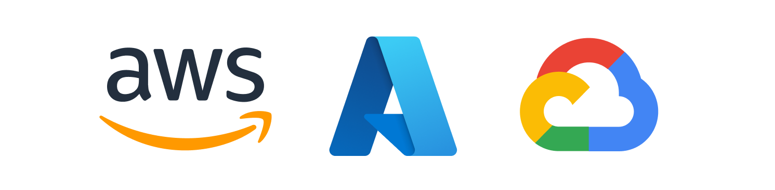
There are many ways to orchestrate your Lakehouse workloads
Lakehouse Platform
Orders
?
Join
Aggregate
Analyze
Clicks
Sessions
Featurize
Train
BI & Data Warehousing
Data Engineering
Data Streaming
Data Science & ML
Notes:
When looking for orchestration solutions for the lakehouse there are different approaches including:
In house, DIY custom solutions
Open source solutions
Cloud vendor specific solutions
All these solutions are external to the lakehouse and so introduce their own challenges…

Slide 57
External orchestrators create challenges
Hard to use for many practitioners
Difficult to understand root cause when issues occur
Complex architecture to manage and maintain
Data teams are less productive
Bad data lowers value of downstream applications
Higher cost of ownership and lower reliability
These tools are not unified with your Lakehouse
Notes:
External orchestrator are lacking when used to orchestrate a workload running on the lakehouse in one or more ways:
There is a non-trivial learning curve for usage by different roles in the organization (data engineers, analysts, data scientists) which result in reduced productivity.
Inferior observability, limits the ability to recognize issues leading to difficult troubleshooting and lower quality data.
Higher maintenance burden and cost of ownership
The main reason for these is that these solutions are not unified with the laekhouse.

Slide 58
Databricks Workflows
Lakehouse Platform
Workflows
Orders
Join
Aggregate
Analyze
Clicks
Sessions
Featurize
Train
Unified orchestration for data, analytics, and AI on the Lakehouse Platform
BI & Data Warehousing
Data Engineering
Data Streaming
Data Science & ML
Unity Catalog
Simple authoring
Delta Lake
Actionable insights
Proven reliability
Notes:
The Databricks Lakehouse platform provides unified orchestration for data, analytics and AI.
Databricks Workflows is the orchestrator that is deeply integrated within the Lakehouse.
It’s there to reliably power all your recurring or streaming tasks – whether that’s ingestion, analysis or ML.
That integration makes it easier to focus on your work -
we’ll take care of your jobs and workflows – they’ll compute what you need done when and how you want it.

Slide 59


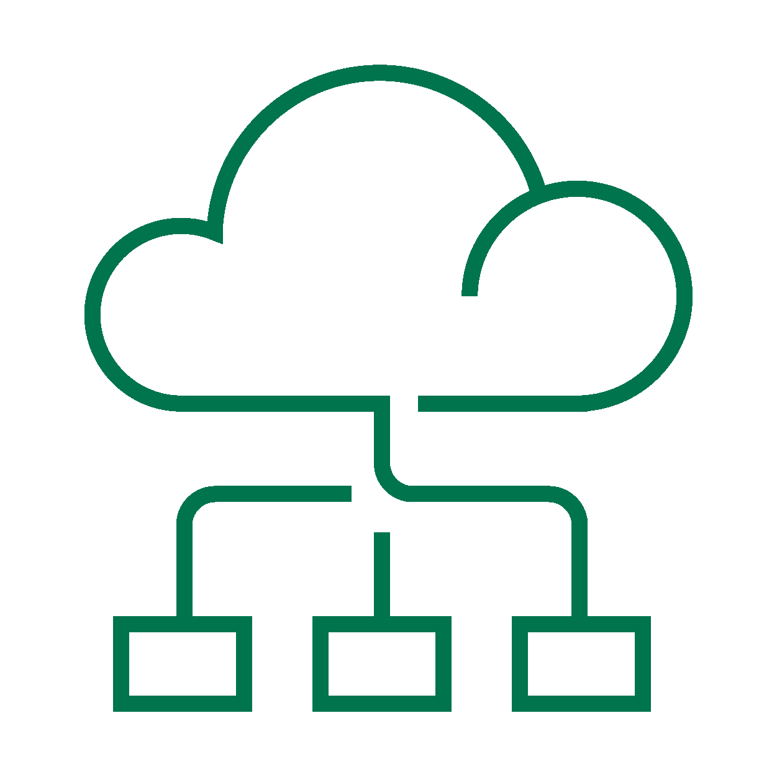
Jobs can be executed on different compute
Development, Ad-Hoc Analysis & Exploration
Production Grade & Operational Use-Cases
Simple, Fast, Reliable, Cost Efficient!
Interactive Clusters
Job Clusters
Serverless Workflows
Interactive or all-purpose clusters can be shared by multiple users.
It is best for performing ad-hoc analysis, data exploration, or development.
Interactive should not be used in Production as they are not cost-efficient.
Job clusters are approximately 50% cheaper as they terminate when the job ends, reducing resource usage and costs.
However, Job clusters are subject to cloud providers start-up times.
With Databricks Workflows, you can re-use the same cluster across Tasks for better price performance!
Serverless Workflows are a fully managed service that are operationally simpler and more reliable
They provide you with faster clusters & auto-scaling capabilities providing you with a better user experience for a lower cost.
With out of the box performance optimizations, Serverless provides you with a lower overall TCO.
Notes:
Repair and Re-Run?

Slide 60
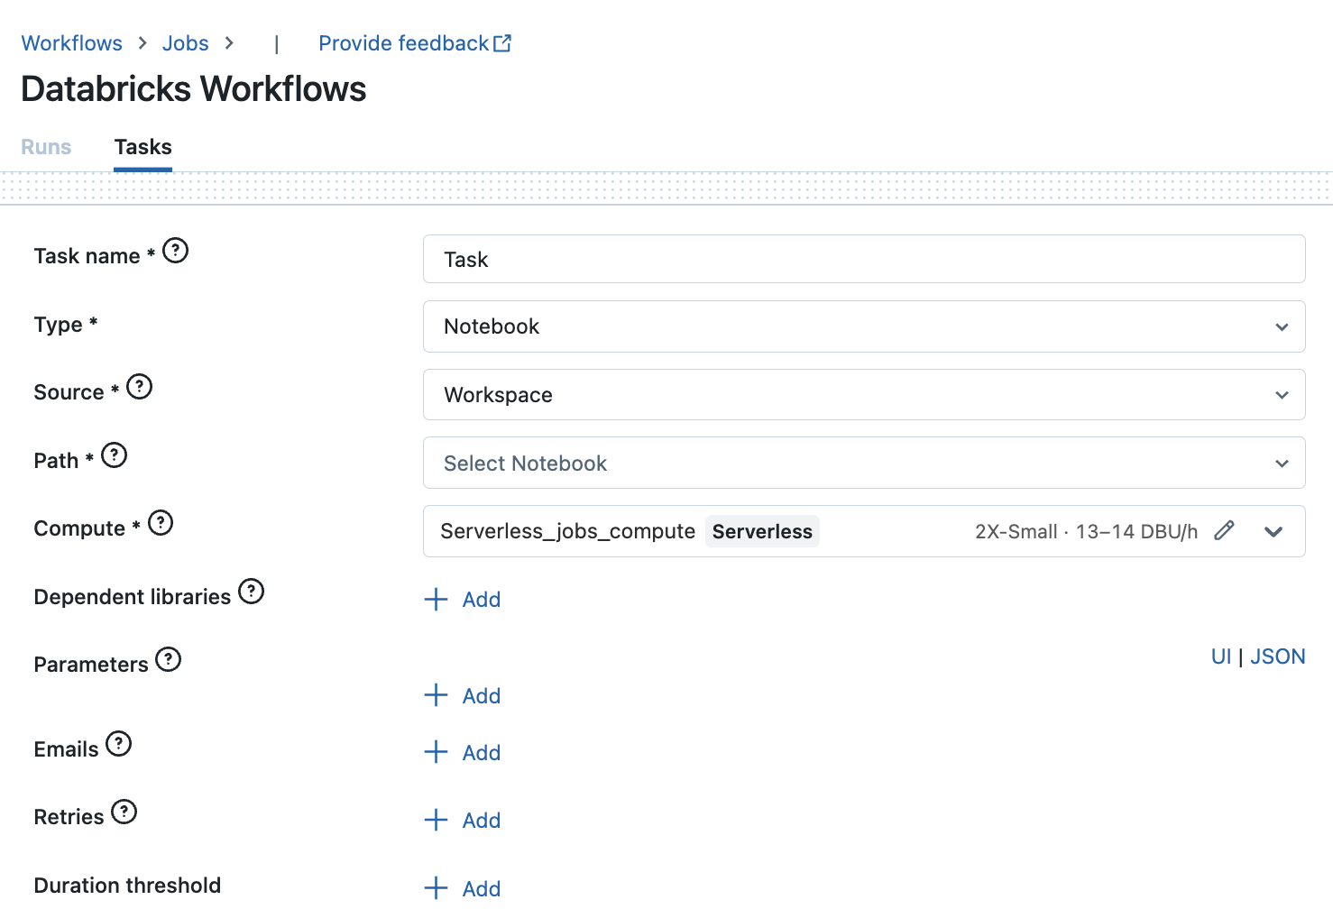
Job Basics
A job is a way to run code in a Databricks cluster or SQL Warehouse.
A job can consist of a single task or can be a large, multi-task workflow with complex dependencies.
You can create and run a job using the UI, the CLI, Terraform, or by invoking the Jobs API

Slide 61
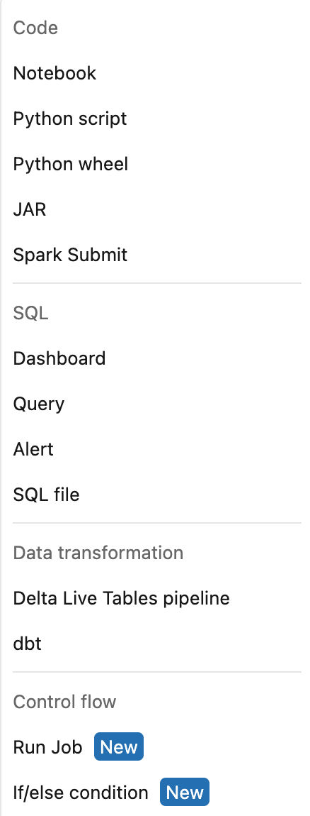
Jobs – Supported Task Types
This list is ever growing covering a
wide variety of task types….

Slide 62
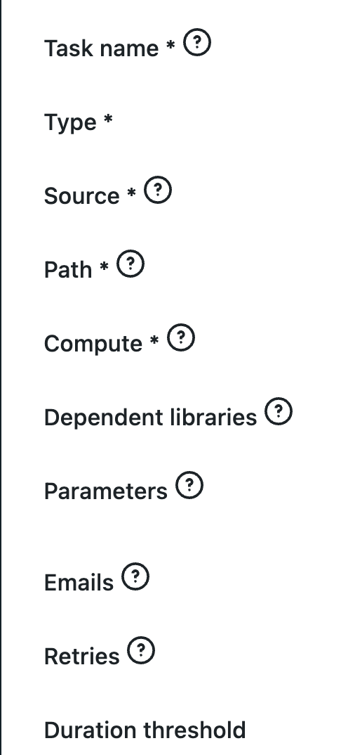
With Workflows, we can also set and specify:

Slide 63





Jobs – Languages Supported
Python
SQL
Scala
R
Java [via a JAR file]

Slide 64
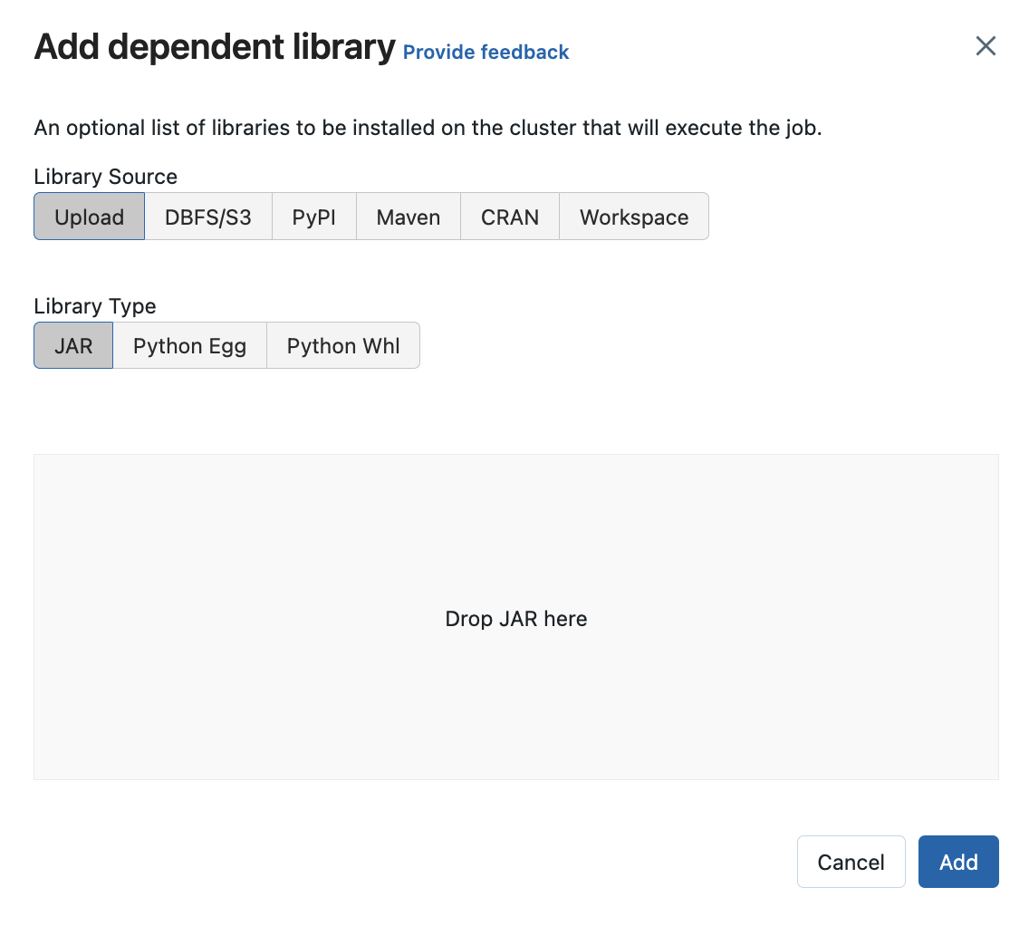
Dependent Libraries
Libraries could be installed from a wide variety of sources like
Maven
CRAN
PyPI
DBFS/Cloud location
Workspace location
Library type could be JAR, Python Egg or Python Wheel
We can also upload from the local machine.

Slide 65
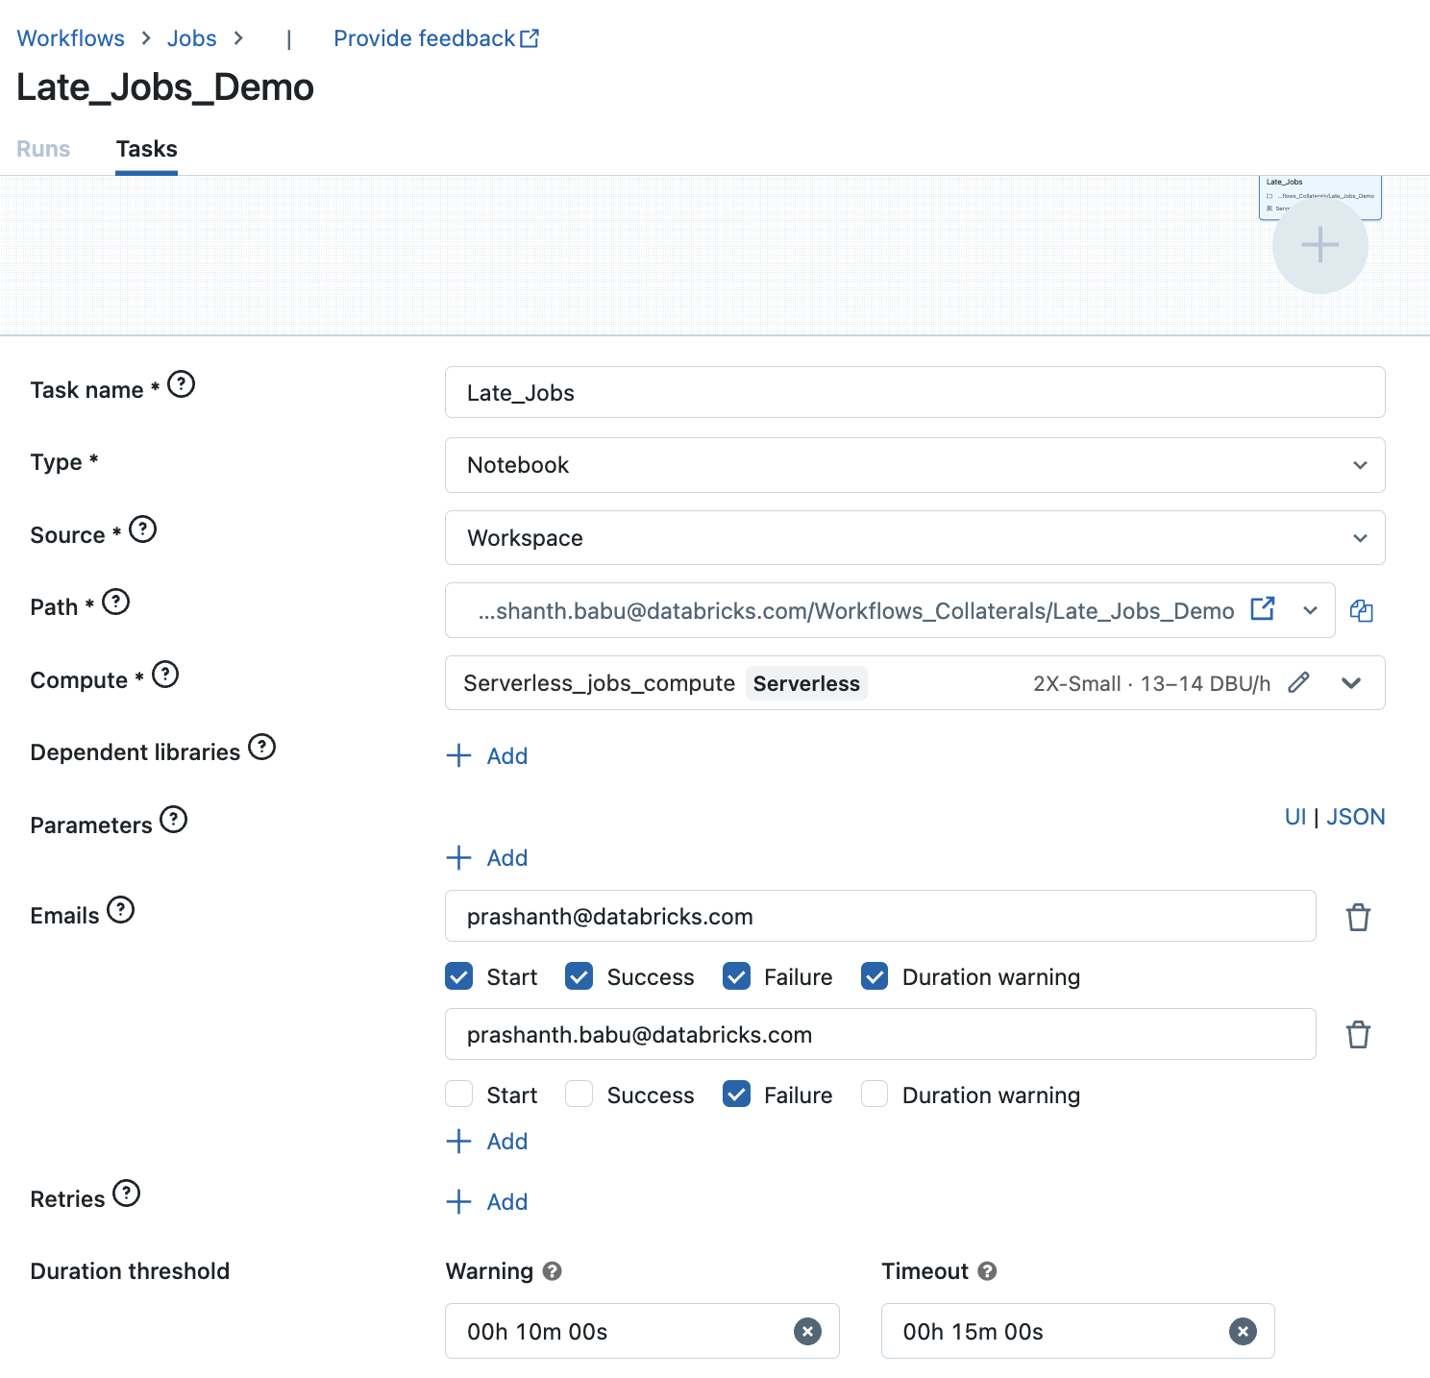
Emails
Each task in a Job could be configured to send emails (optional).
Databricks Workflows triggers emails when the task begins, completes or fails.
These emails could also be triggered in the case of Late Jobs (for duration threshold warning/timeout alerts).

Slide 66
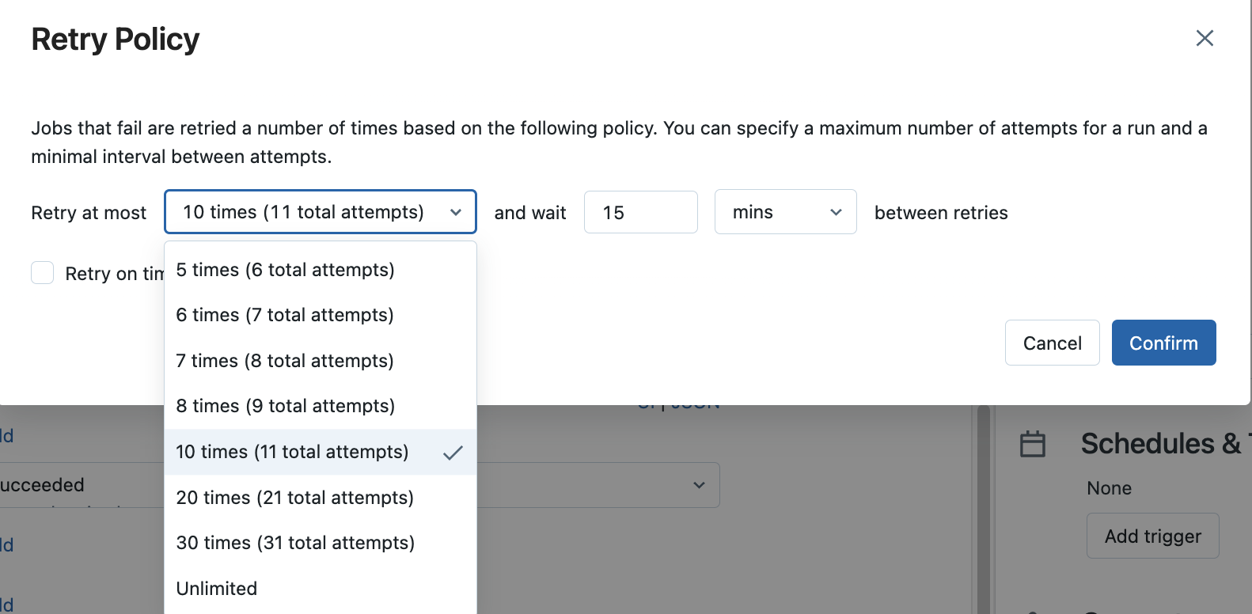
Retry Policy
A policy that determines when and how many times failed runs are retried.
To set the retries for the task, click Advanced options and select Edit Retry Policy.
The retry interval is calculated in milliseconds between the start of the failed run and the subsequent retry run.
Note: if both Timeout and Retries are configured, the timeout applies to each retry.

Slide 67
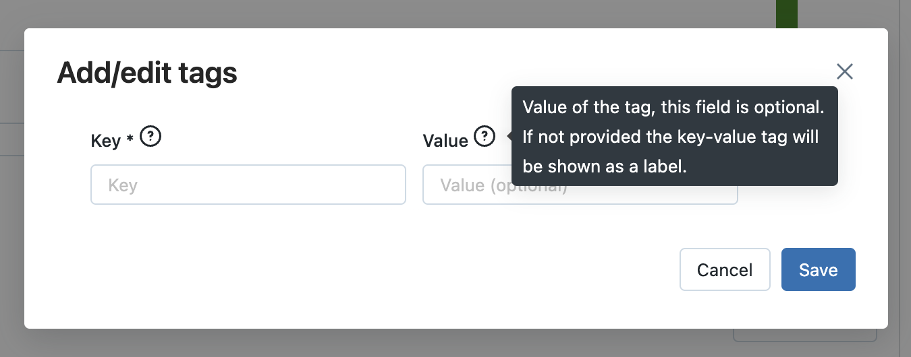
Tags
Tagging jobs allows customers to easily identify and locate jobs by ownership, topic or department.
Tags propagate to job clusters created when a job is run, allowing you to use tags with your existing cluster monitoring.
Tags can contain both key-value pairs and only keys (labels)

Slide 68
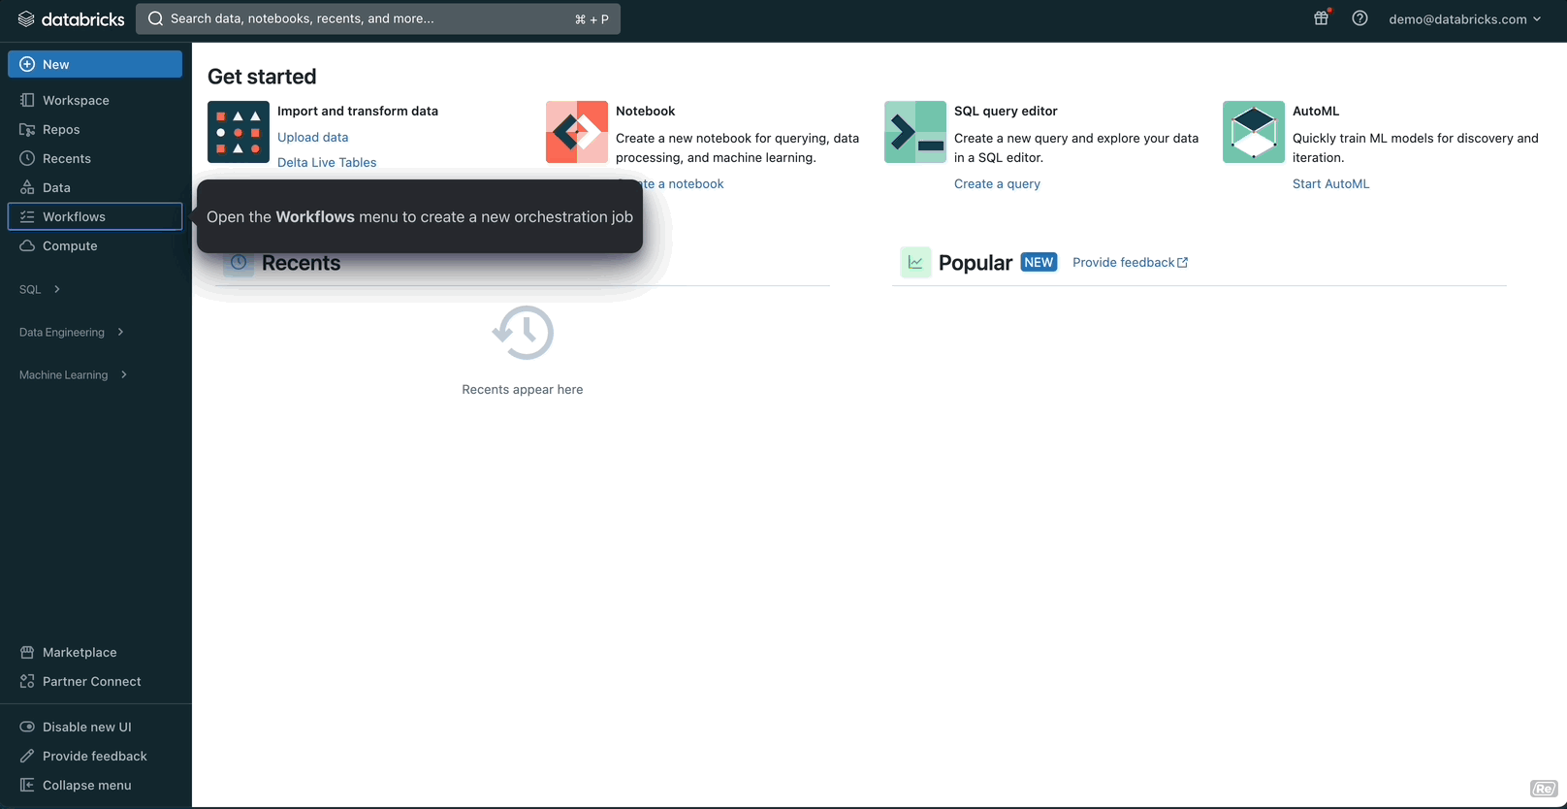
Creating a Databricks Job

Slide 69

Add a second task

Slide 70
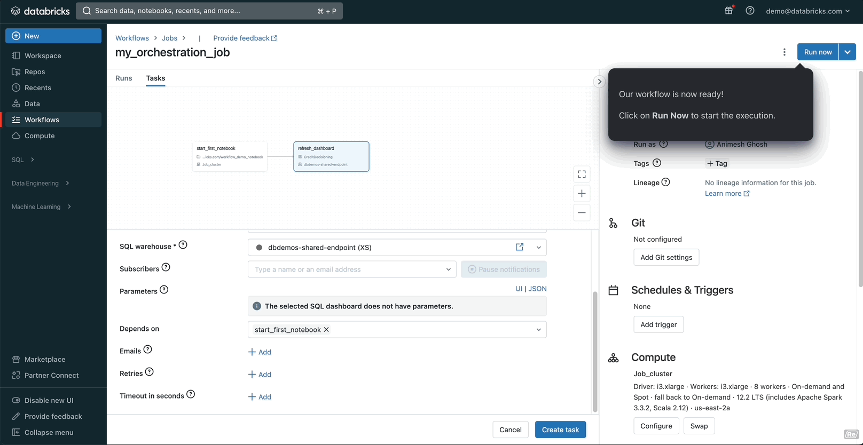
Running and debugging your Job

Slide 71
Workflows Best Practices
Unit of Orchestration: In Databricks Workflows, a unit of orchestration is called a Job. Jobs consist of one or more tasks and control flows can be established between tasks. Jobs support different triggers like manual, scheduled (cron), API, file arrival, Delta table update, and continuous (streaming).
Supported Task Types and Languages: Databricks workflows support a wide variety of task types and languages including Python, SQL, Scala, R, and Java via a JAR file.
Dependent Libraries: Libraries can be installed from a wide variety of sources like Maven, CRAN, PyPI, DBFS/Cloud location, Workspace location, and can also be uploaded from the local machine.
Email Notifications: Each task in a Job could be configured to send emails when the task begins, completes, or fails.
Use of Job Clusters: After implementing the data processing and unit testing, and when code is ready to be operationalized, the job should always switch to running on a Job Cluster. Only Job Clusters should be used in Production as they are cost-efficient and terminate when the job ends, reducing resource usage and costs.
Standardize DevOps processes (CI/CD): Continuous integration and continuous delivery (CI/CD) is becoming an increasingly necessary process for data engineering and data science teams.
Use Automated Workflows for Jobs: Setting up automated workflows for jobs can help reduce unnecessary manual tasks and improve productivity. Databricks Workflows orchestrates data processing, machine learning, and analytics pipelines on the Databricks Data Intelligence Platform. It is a fully managed orchestration service integrated with the Databricks platform.
Delta Live Tables: Delta Live Tables is a declarative framework for building reliable, maintainable, and testable data processing pipelines. Delta Live Tables manages task orchestration, cluster management, monitoring, data quality, and error handling.

Slide 72
Cost analysis and optimization

Slide 73
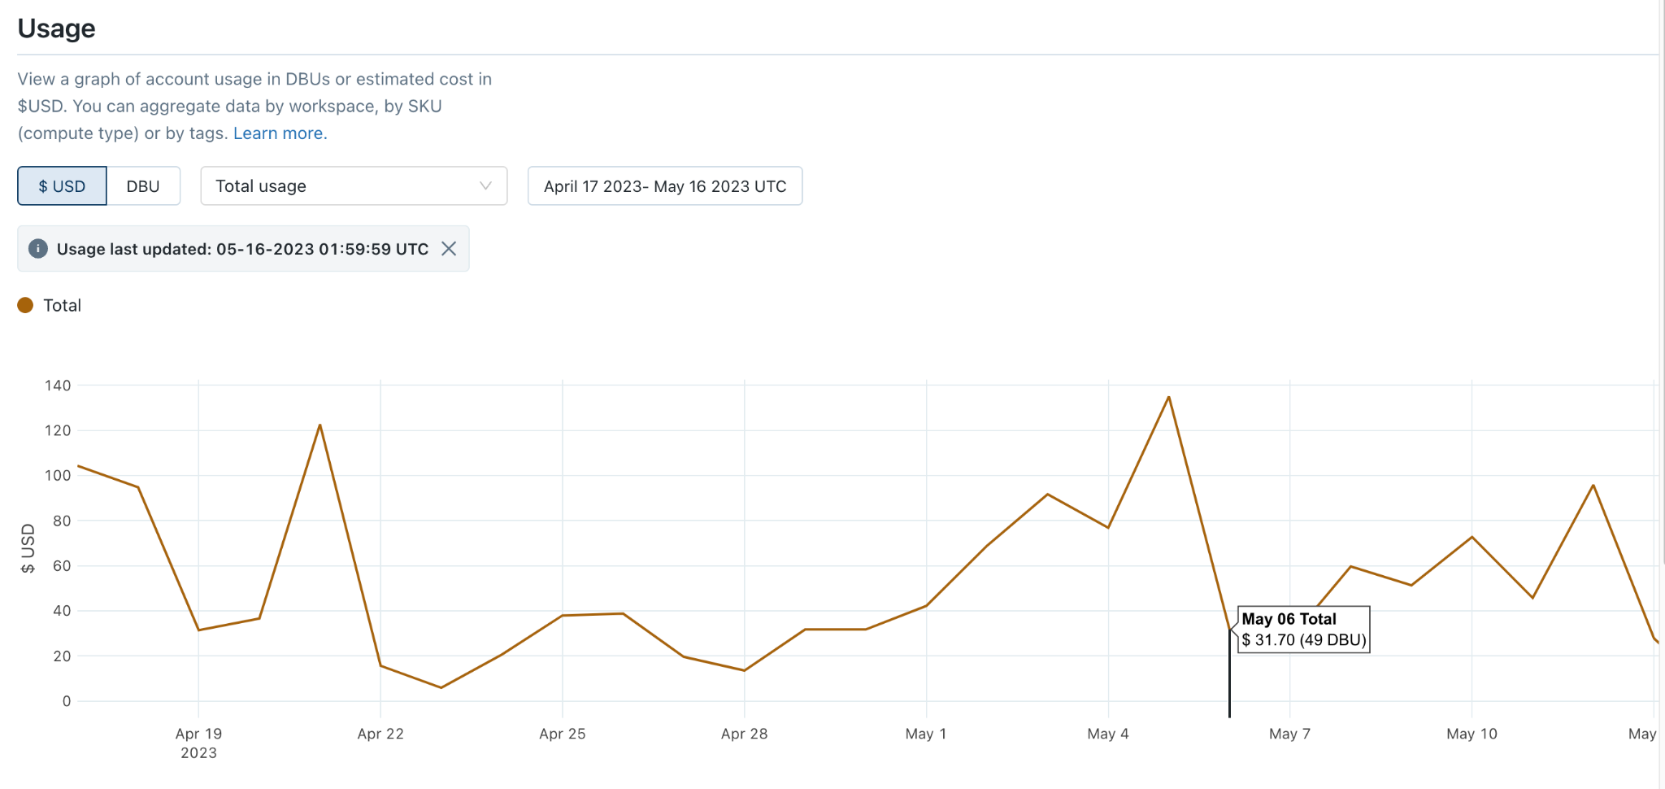
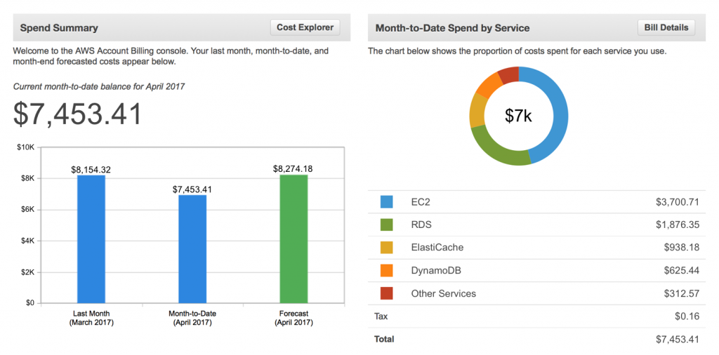
What is Observability?
Observability is a key aspect of a data platform which
provides visibility into detailed platform usage
helps to correlate the spend/cost implications with different use cases
enables Security & Audit of data platform access

Slide 74
What is Observability?
Platform Spend
Which are my top spending clusters?
Which are my top spending jobs?
Which are my top spending projects?
Security and Audit
Monitor and track Users and User Groups access to data of different classifications
Track Account Logins & modifications
Platform Usage
How many new jobs are being added every month?
Which are my long running jobs/queries?
What are the cluster & job configs being used?
How many users are there in the workspace?
Data Observability & Optimisation
Which are my largest tables?
Which tables have the most frequent writes?
Which columns to z-order by?
Resource Utilisation
Which are my lowest utilised clusters?
How is utilisation trending at a hour/min level

Slide 75
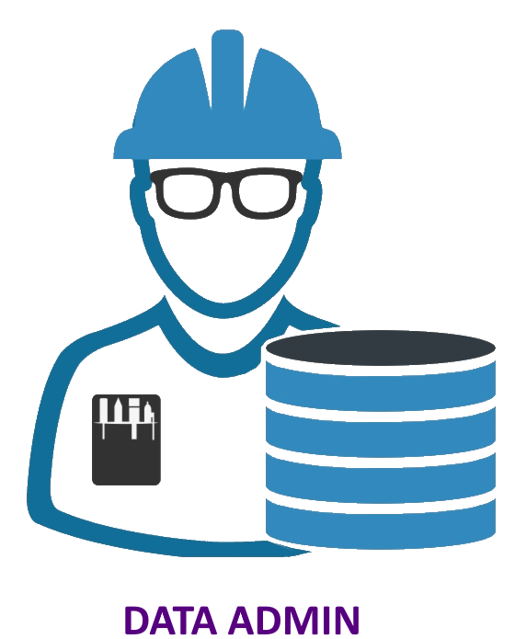

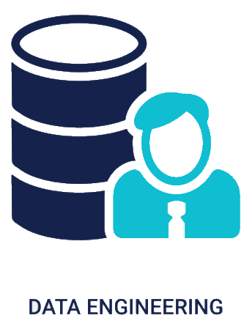
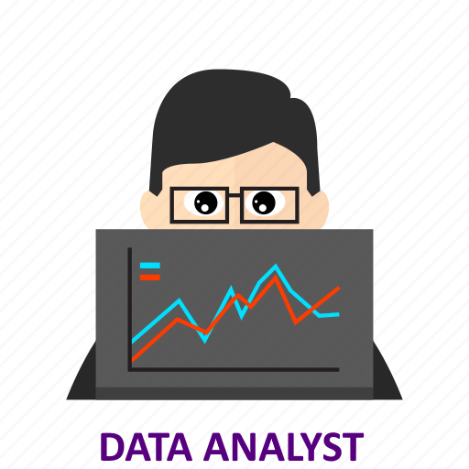

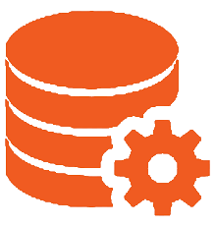



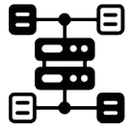



Platform Observability in Databricks
System Tables
UX
Insights
Gold Fact + Dimension System Tables
System Tables
data plane
Enrichment
Bronze Fact + Dimension System Tables
Continuous Export
Data sources
Audit
Billable usage
Compute
Orchestration
Platform
System Tables Pipeline Infrastructure
Notes:
Unified search/analytics (customer engagement/sentiment). Start at the UI, dive into system tables for advanced analytics (drill-down right from the UI w/canned queries recreating the UI results)

Slide 76

System Tables
System Tables are a Databricks-hosted analytical store for all of Databricks operational data’s warm path used for historical customer observability, including:
Audit/lineage analytics
Cost/usage analytics
Efficiency analytics
SLO analytics
Data Quality analytics
for jobs, notebooks, clusters, SQL/ML endpoints, etc.
Notes:
Allows to unify search, simplify analytics, standardize UX on top

Slide 77

Audit Logs
Audit Log events in System tables helps you to answer common account usage questions
Who accessed this table?
Which users accessed a table within the last day?
Which tables did a user access?
View all permissions changes
View the most recently run notebook commands

Slide 78

Billable usage
Analyze and optimize DBU consumption by leveraging usage tables
What is the daily trend in DBU consumption?
How many DBUs of each SKU have been used throughout this month?
How much of each SKU did a workspace use on June 1?
Which jobs consumed the most DBUs?
How much usage can be attributed to resources with a certain tag?
Show me the SKUs where usage is growing
What is the usage trend of All Purpose Compute (Photon)?

Slide 79


Table and Column Lineage
Build on Unity Catalog’s data lineage feature, allowing you to programmatically query lineage data to fuel decision making and reports.
There are two lineage system tables:
system.access.table_lineage
system.access.column_lineage

Slide 80
System Tables Roadmap
System Tables are highly evolving to add a wide range of other useful data which makes it a one-stop shop for all observability needs
Data Marketplace analytics
Delta Auto Maintenance
Clusters
List Prices
Account / Contract Prices
Jobs & Tasks
Warehouse events
Notes:
Allows to unify search, simplify analytics, standardize UX on top

Slide 81
Cost analysis and optimization (Gilead-DnA Infra)

Slide 82
Divider Slide with Image

Slide 83
Divider Slide with Image

Slide 84
Divider Slide with Image

Slide 85
This is a Single-Column Content Slide
This is for slide content. The main type size is 20pt, and type will not resize if the amount of content on the slide surpasses the space available. Please use the global font size adjustment next to the numerical font size selector to decrease font size across the entire text area.
This is a bullet style
This is a sub-bullet
This is a third level bullet

Slide 86
This is a Single-Column Content Slide
This is for slide content. The main type size is 20pt, and type will not resize if the amount of content on the slide surpasses the space available. Please use the global font size adjustment next to the numerical font size selector to decrease font size across the entire text area.
This is a bullet style
This is a sub-bullet
This is a third level bullet

Slide 87
This is a Two-Column Content Slide
This is for slide content
Bullet style example
This is a sub-bullet
This is a third level bullet
This is for slide content
Bullet style example
This is a sub-bullet
This is a third level bullet

Slide 88
This is a Three-Column Content Slide
This is for slide content
Bullet style example
This is a sub-bullet
This is a third level bullet
This is for slide content
Bullet style example
This is a sub-bullet
This is a third level bullet
This is for slide content
Bullet style example
This is a sub-bullet
This is a third level bullet

Slide 89
Content + Infographic
Cell 1 | Cell 2 | Cell 3 | Cell 4
Put table content here. | Put table content here. | Put table content here.
Put table content here.
This slide is for copy on the left & some sort of supporting graphical image or photo on the right-hand side.

Slide 90
Content + Infographic
Cell 1 | Cell 2 | Cell 3 | Cell 4
Put table content here. | Put table content here. | Put table content here.
Put table content here.
This slide is for copy on the left & some sort of supporting graphical image or photo on the right-hand side.

Slide 91
Place Headline Here
This is a side-by-side content slide – it provides an option for simpler slide content.
You can put a few points of body copy in here and the text area will expand from the center to fill the content space.

Slide 92
Place Headline Here
This is a side-by-side content slide – it provides an option for simpler slide content.
You can put a few points of body copy in here and the text area will expand from the center to fill the content space.

Slide 93
This is a key point example. Text only.

Slide 94
This is a key point example. Text only.

Slide 95
This is a key point example. Text only.

Slide 96
This is a key point example. Text only.

Slide 97
This is a key point example. Text only.

Slide 98
This is a key point example. Text only.

Slide 99
This is a key point.
You can compare two things.

Slide 100
This is a key point.
You can compare two things.

Slide 101
Key point + add custom image

Slide 102
Full Page Image with Large Call Out

Slide 103
Full Page Image with Large Call Out

